Slide 1
On the Northbound of the River Danube
C4 Czech Republic
2nd - 4th March 2022

Slide 2
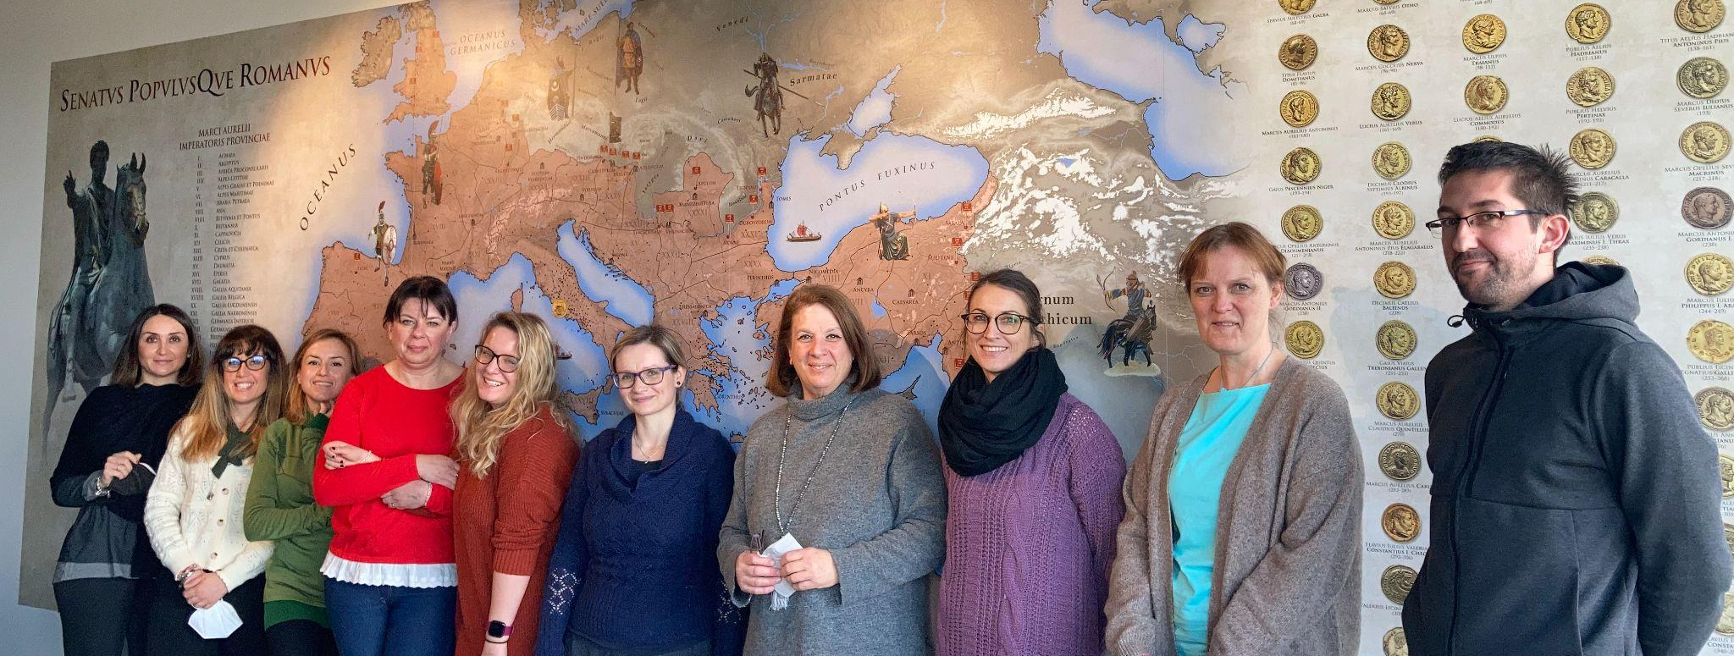
Ref.: Erasmus+ / KA2 Cooperation for innovation and the exchange of good practices
Strategic Partnerships - KA229 School Exchange Partnerships
Project Ref. No.: 2019-1-AT01-KA229-051197
Project title: On The Traces Of Ancient Europe

Slide 3
Here on the other side of the river Danube, close to the Empire’s borders, you will see the simple life of Germanic tribes.
You will also observe the everyday life of Roman soldiers, living in the foreign country for years, waiting for orders, trading with local tribes and building enormous camps containing such necessities as hospitals, spas, and others.
„Look back over the past, with its changing empires that rose and fell, and you can foresee the future, too. “
Marcus Aurelius

Slide 4
C4 Mobility Programme
Tuesday 1st March
Arrival and accommodation in a local hotel
Wednesday 2nd March
8:30 Welcoming ceremony
9:00 Tour of the school
10:00 Job shadowing
11:00 Meeting the major
12:00 Lunch
14:00 Workshop: Organization and planning
15:00 Methodology workshop: Bc. Benjamin Juráň: Cursus Honorum
Faculty of Arts at Masaryk University Brno
18.00 Dinner

Slide 5
Thursday 3rd March
9:00 Workshop training: Mgr. Marek Vlach, Ph.D.: Gateway to the Roman Empire,
Institute of Archeology Brno
13:00 Lunch
14:00 History training: Mgr. Petr Kubín: The Romans and the Germans
in the Region Under Palava - Regional Museum in Mikulov
18.00 Dinner
19.00 Local history tour
Friday 4th March
9:00 Job shadowing
10:00 Information about Stuff joint meeting in Croatia and Italy
10:15 Collection of project ideas
11:00 Lunch
14:00 Art workshop: Mrs. Miroslava Svehlova – Glass Beads - Artissimo Brno
17.00 Brno sights - voluntary
18.00 Dinner

Slide 6
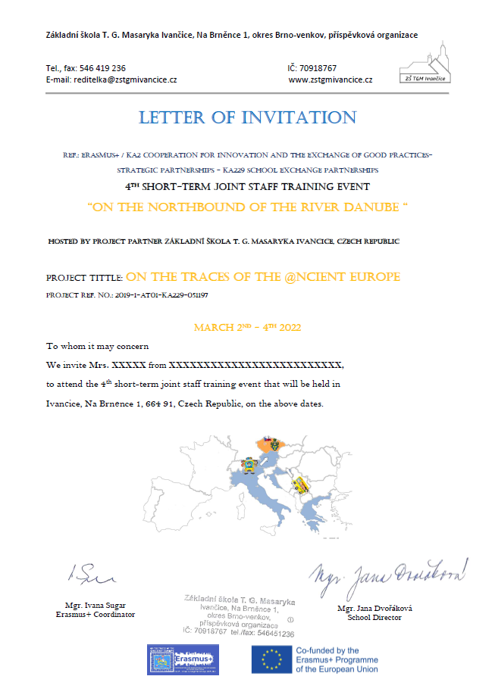
Letter of invitation

Slide 7
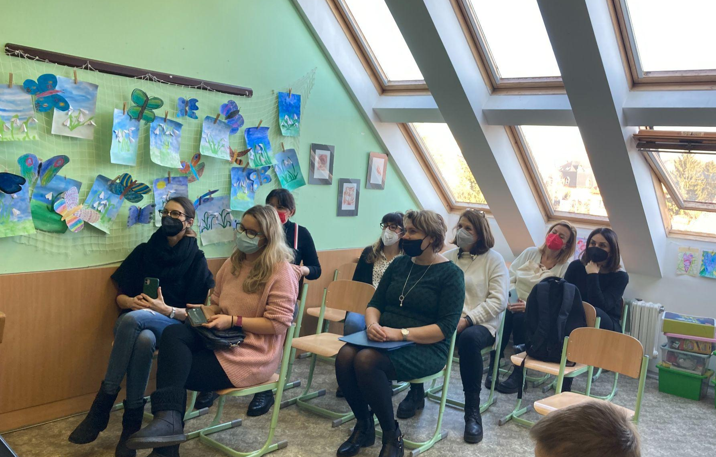
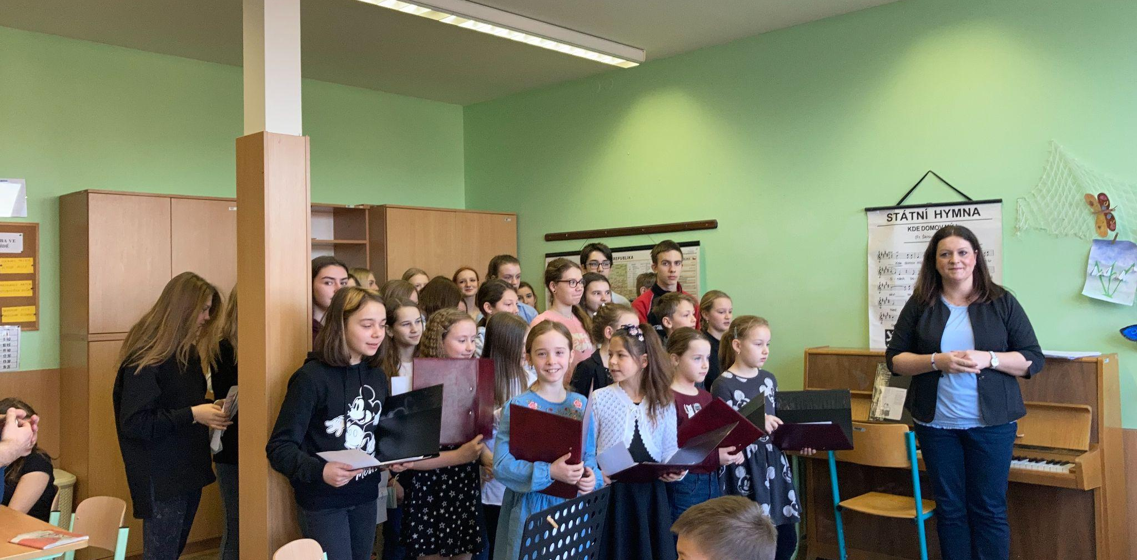
Welcoming ceremony

Slide 8
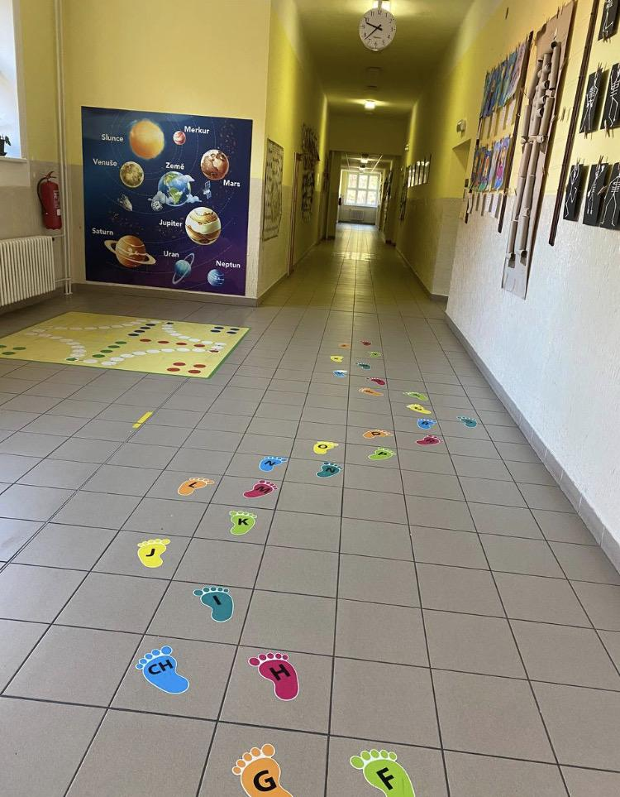
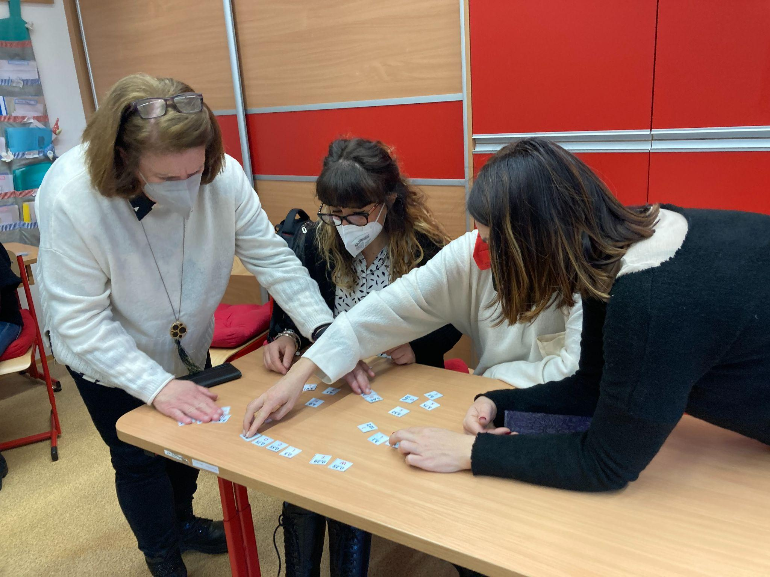
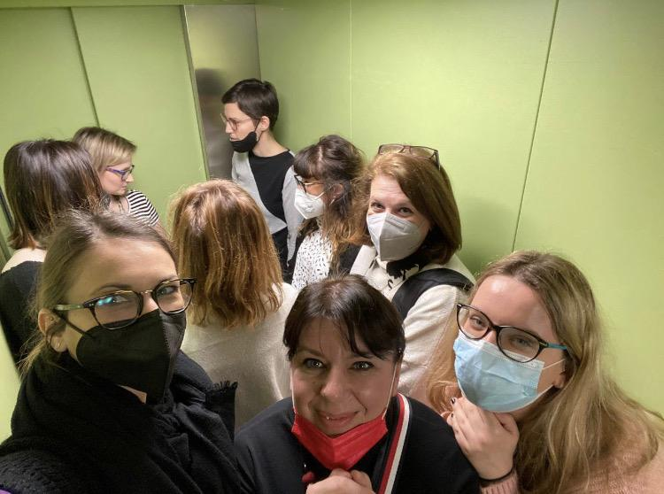
Tour of the school

Slide 9
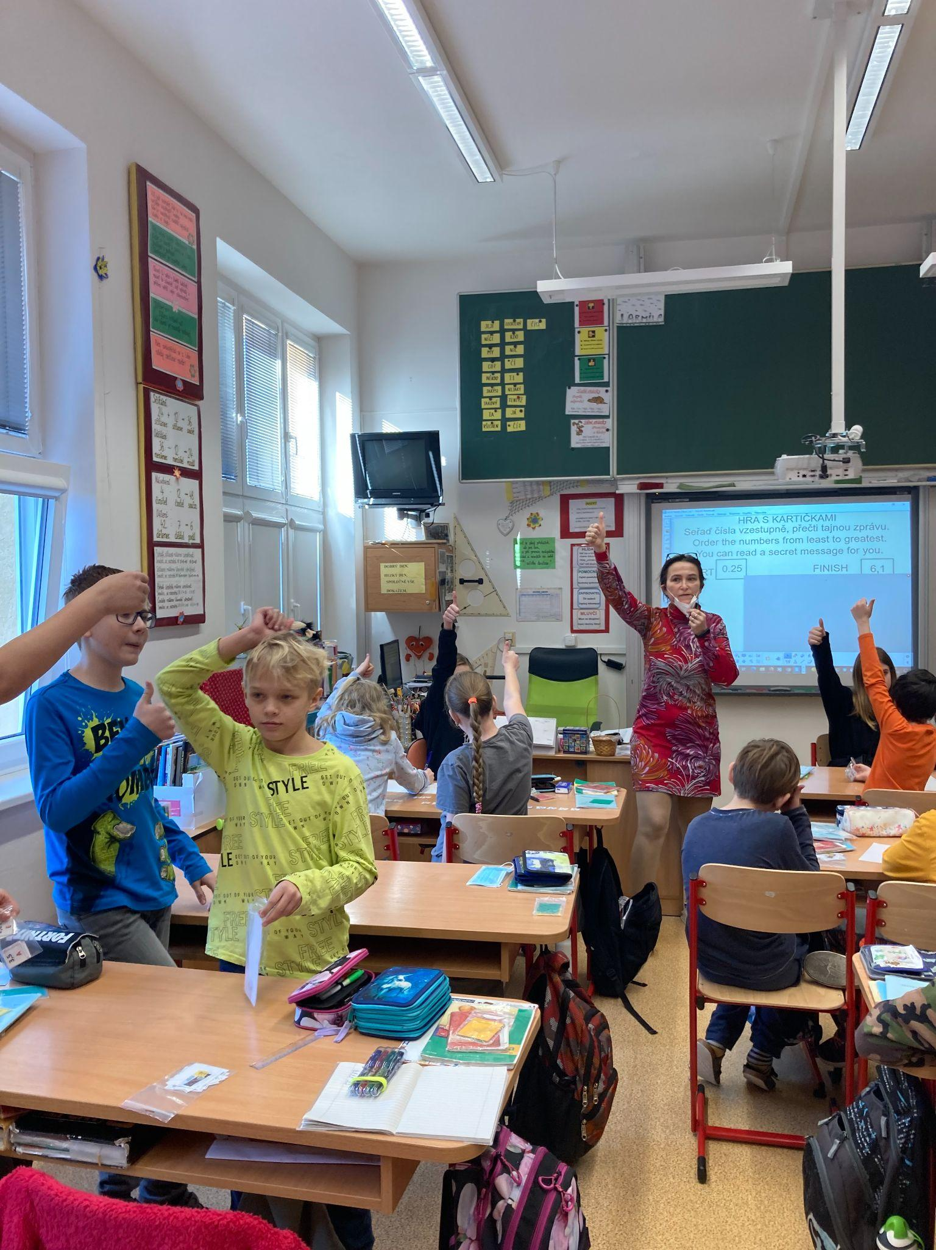
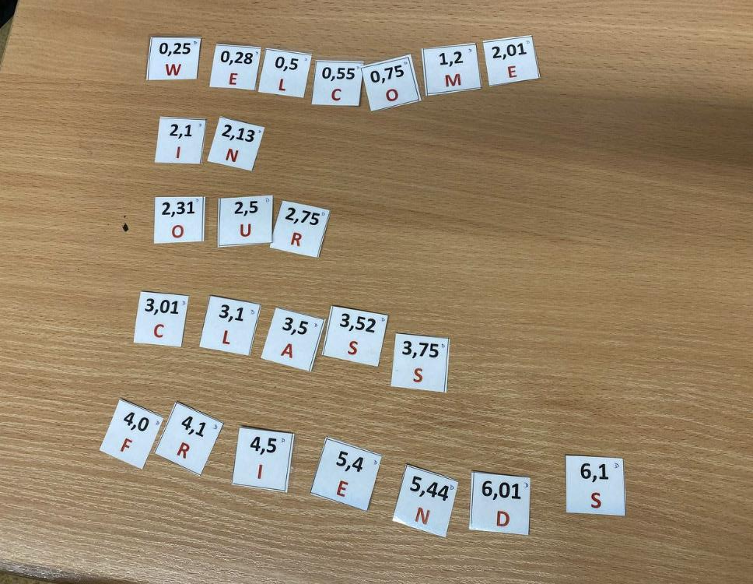
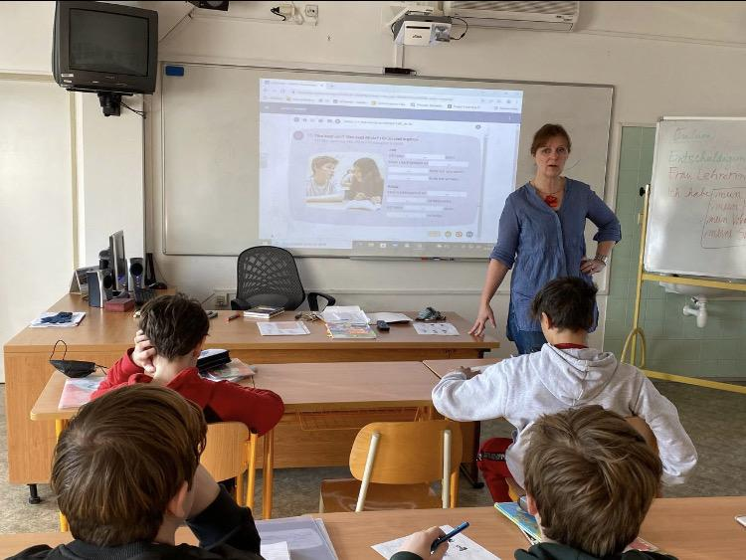
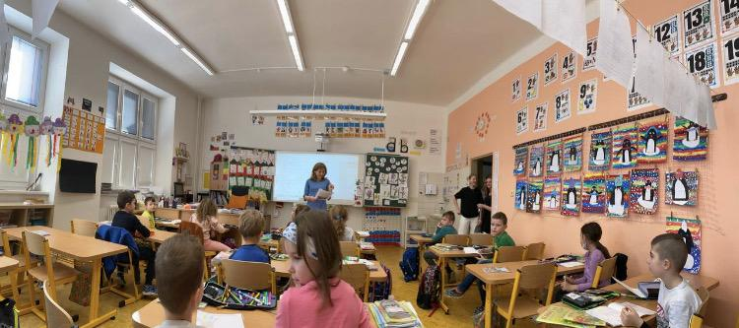
Job-shadowing

Slide 10
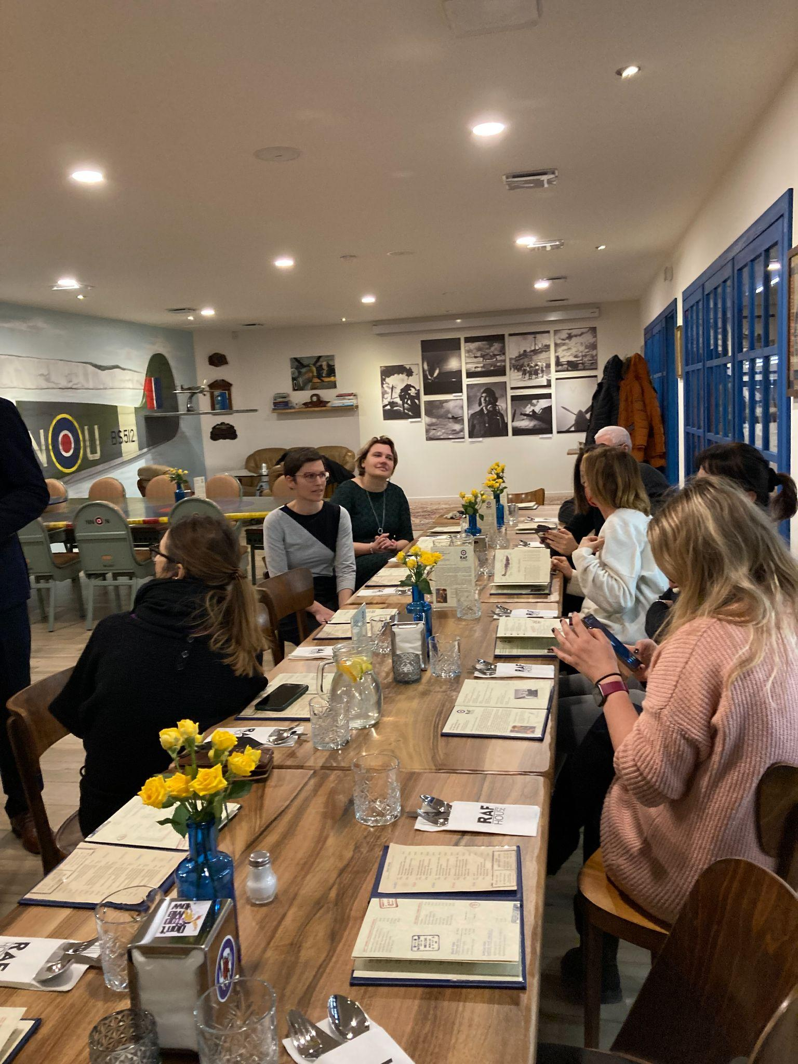
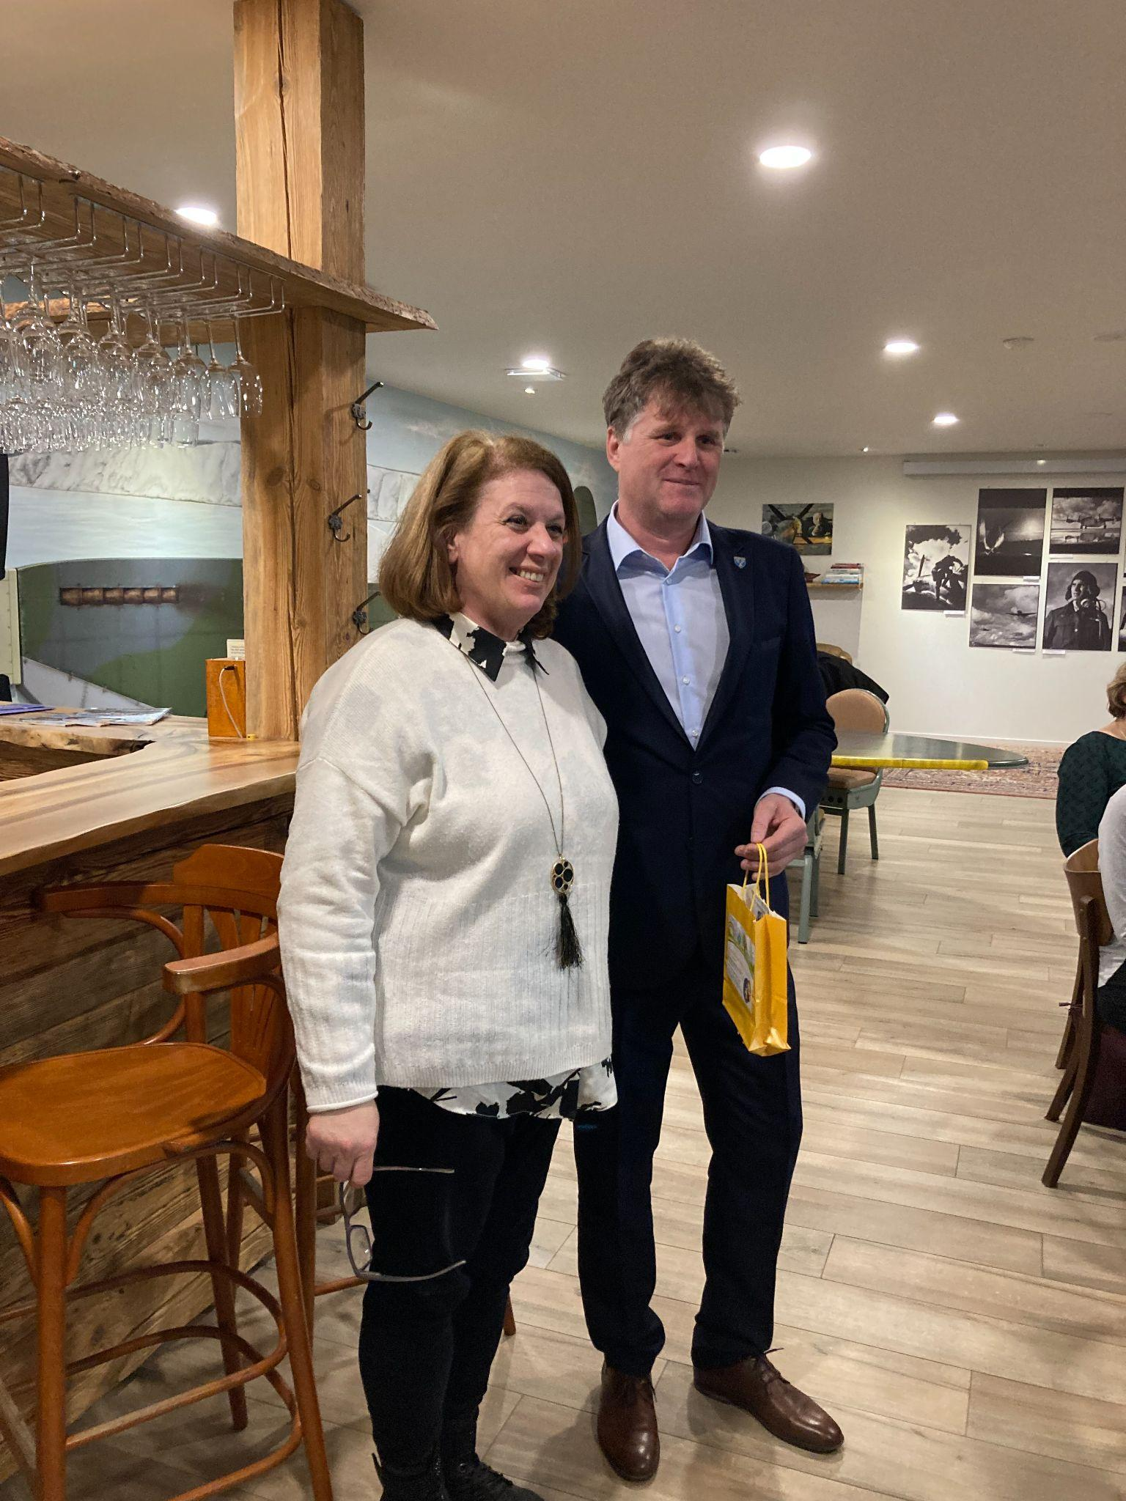
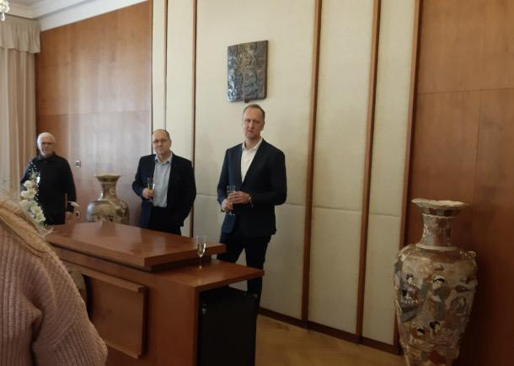
Meeting the major

Slide 11
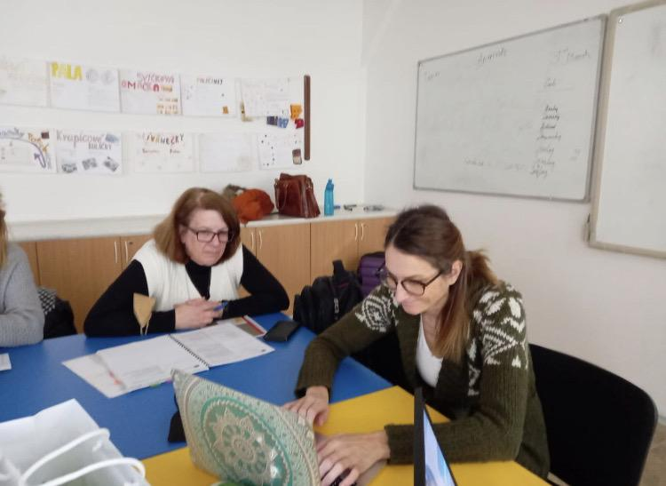
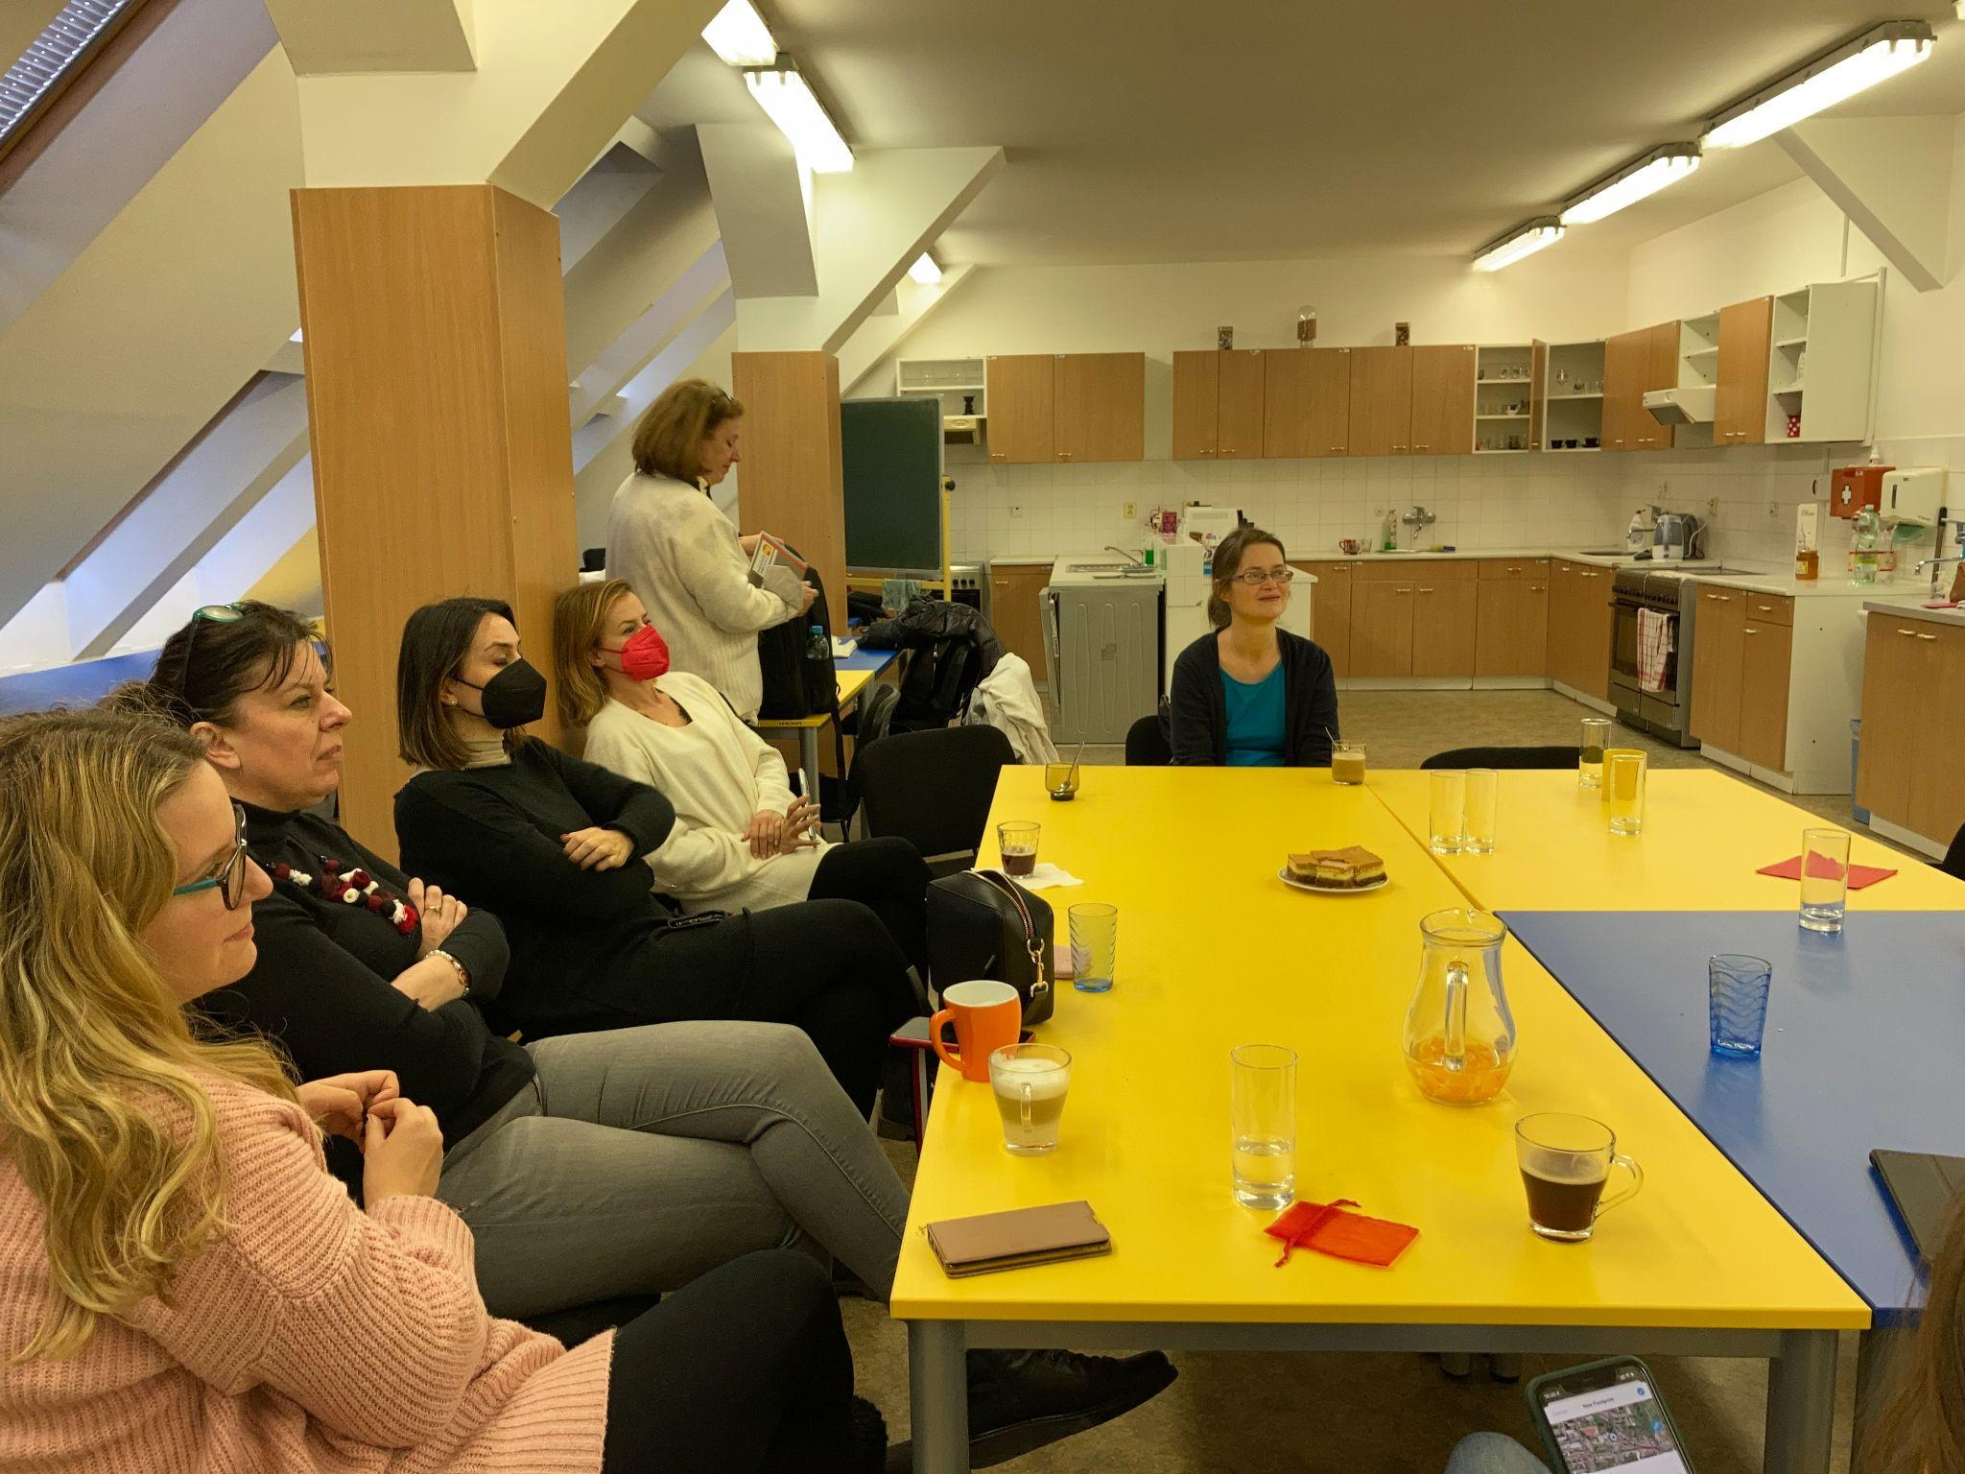
Organizing and planning

Slide 12
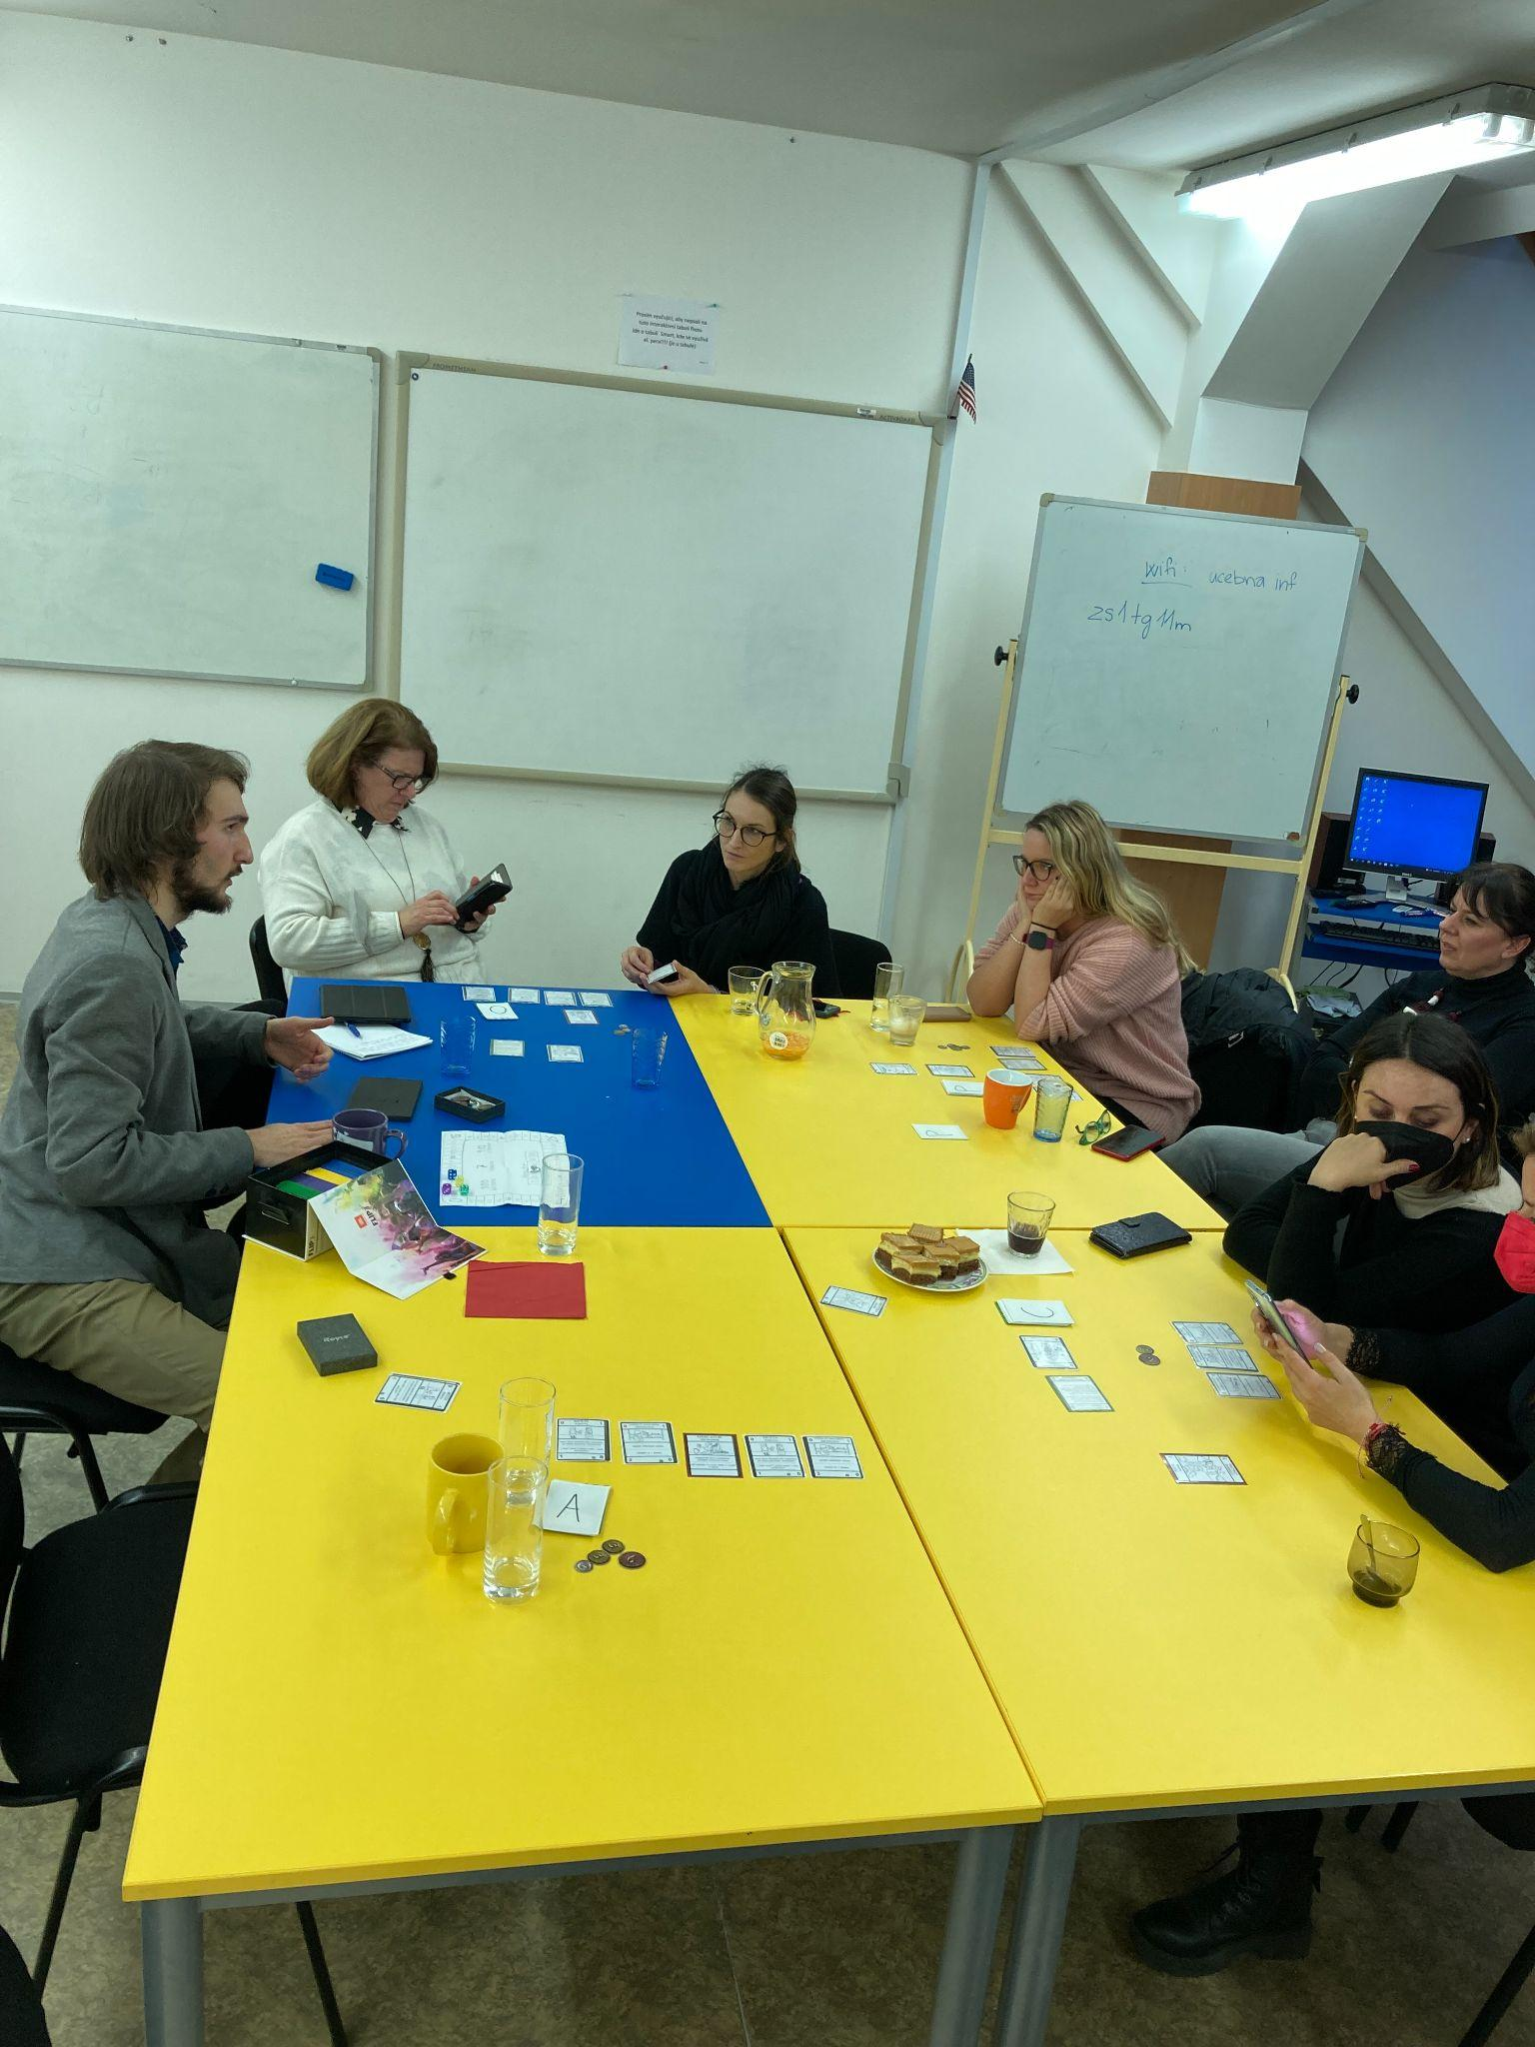
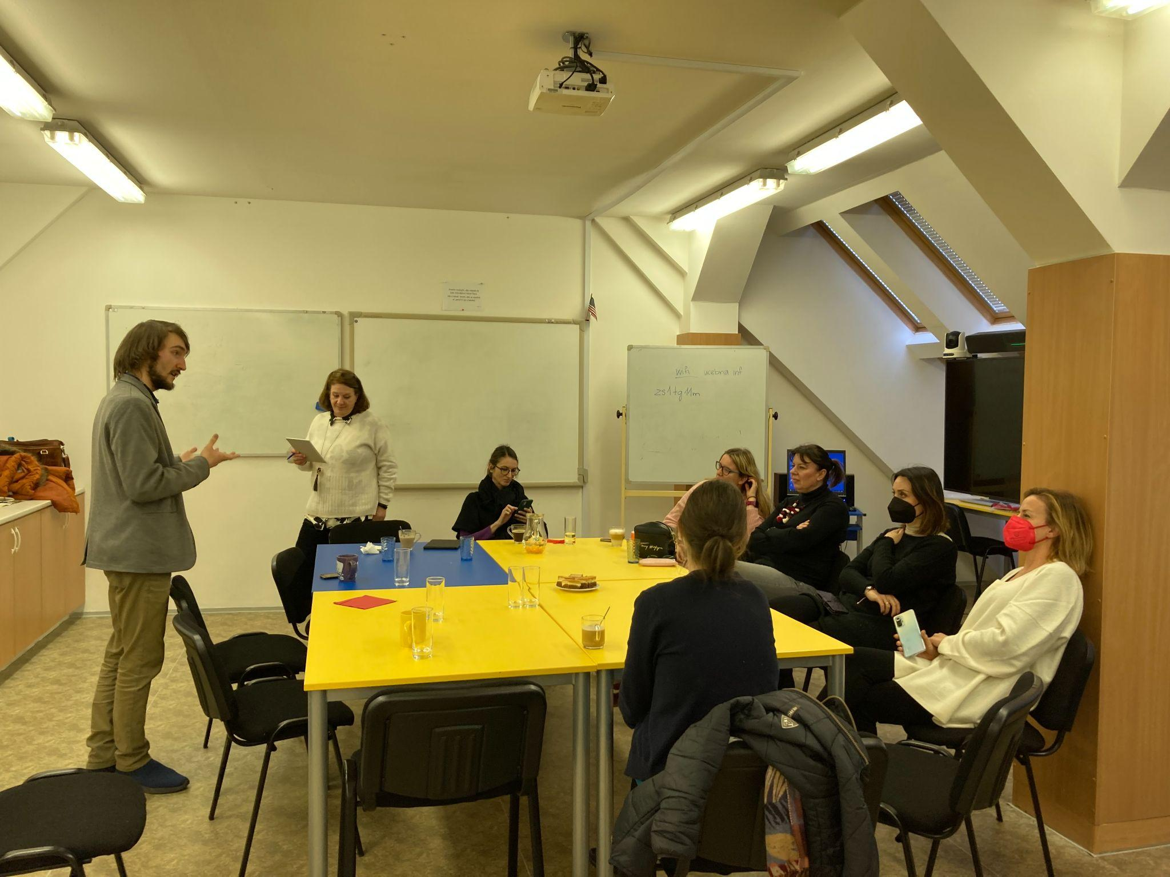
Methodology workshop: Bc. Benjamin Jurán Cursus Honorum
Faculty of Arts at Masaryk University Brno

Slide 13
Cursus Honorum
Cursus Honorum is an asymetrical card game for 4 players, simulating a political career in the late Roman republic. Each player begins the game with a different bonus and can achieve victory through no fewer than 3 ways. No knowledge of the ancient world is necessary to play - on the contrary, the aim is to teach facts colaterally, sort of "by the way".
Benjamin Jurán

Slide 14
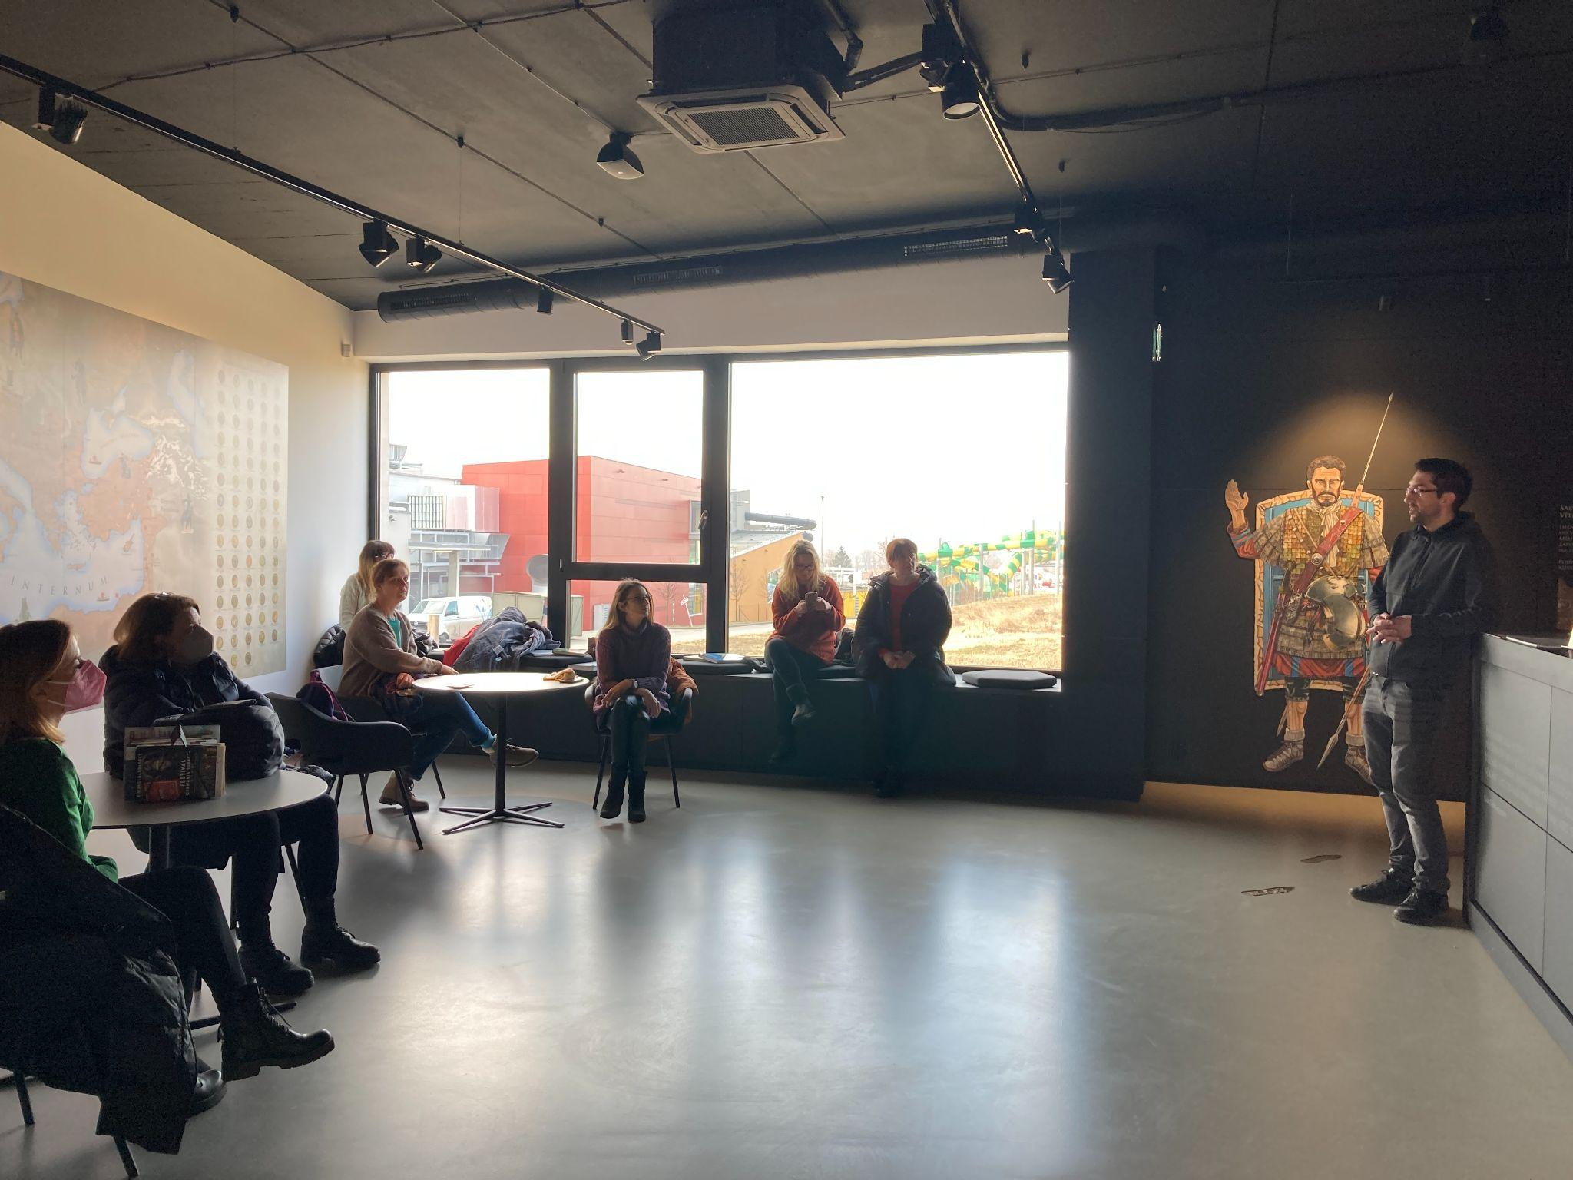
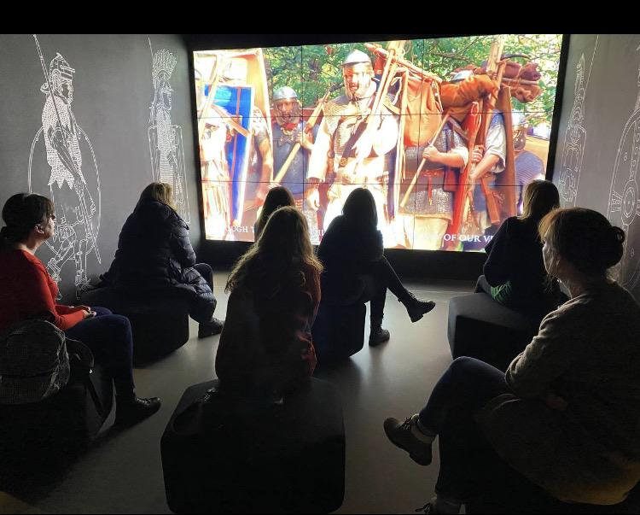
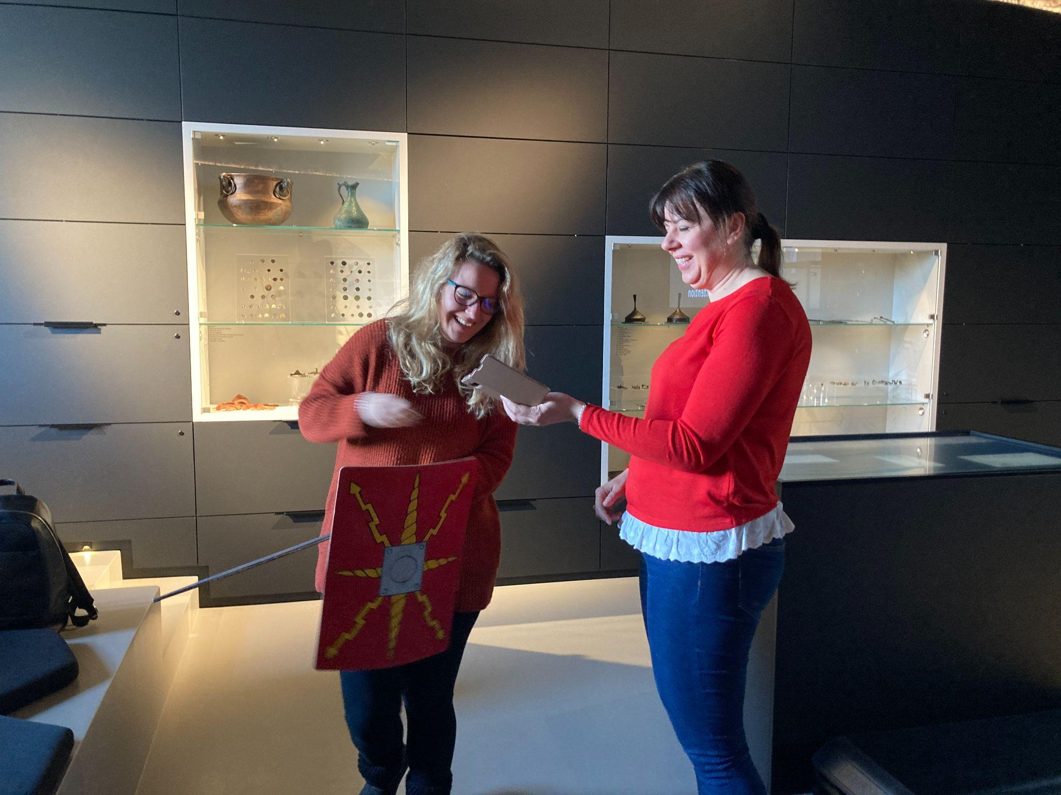
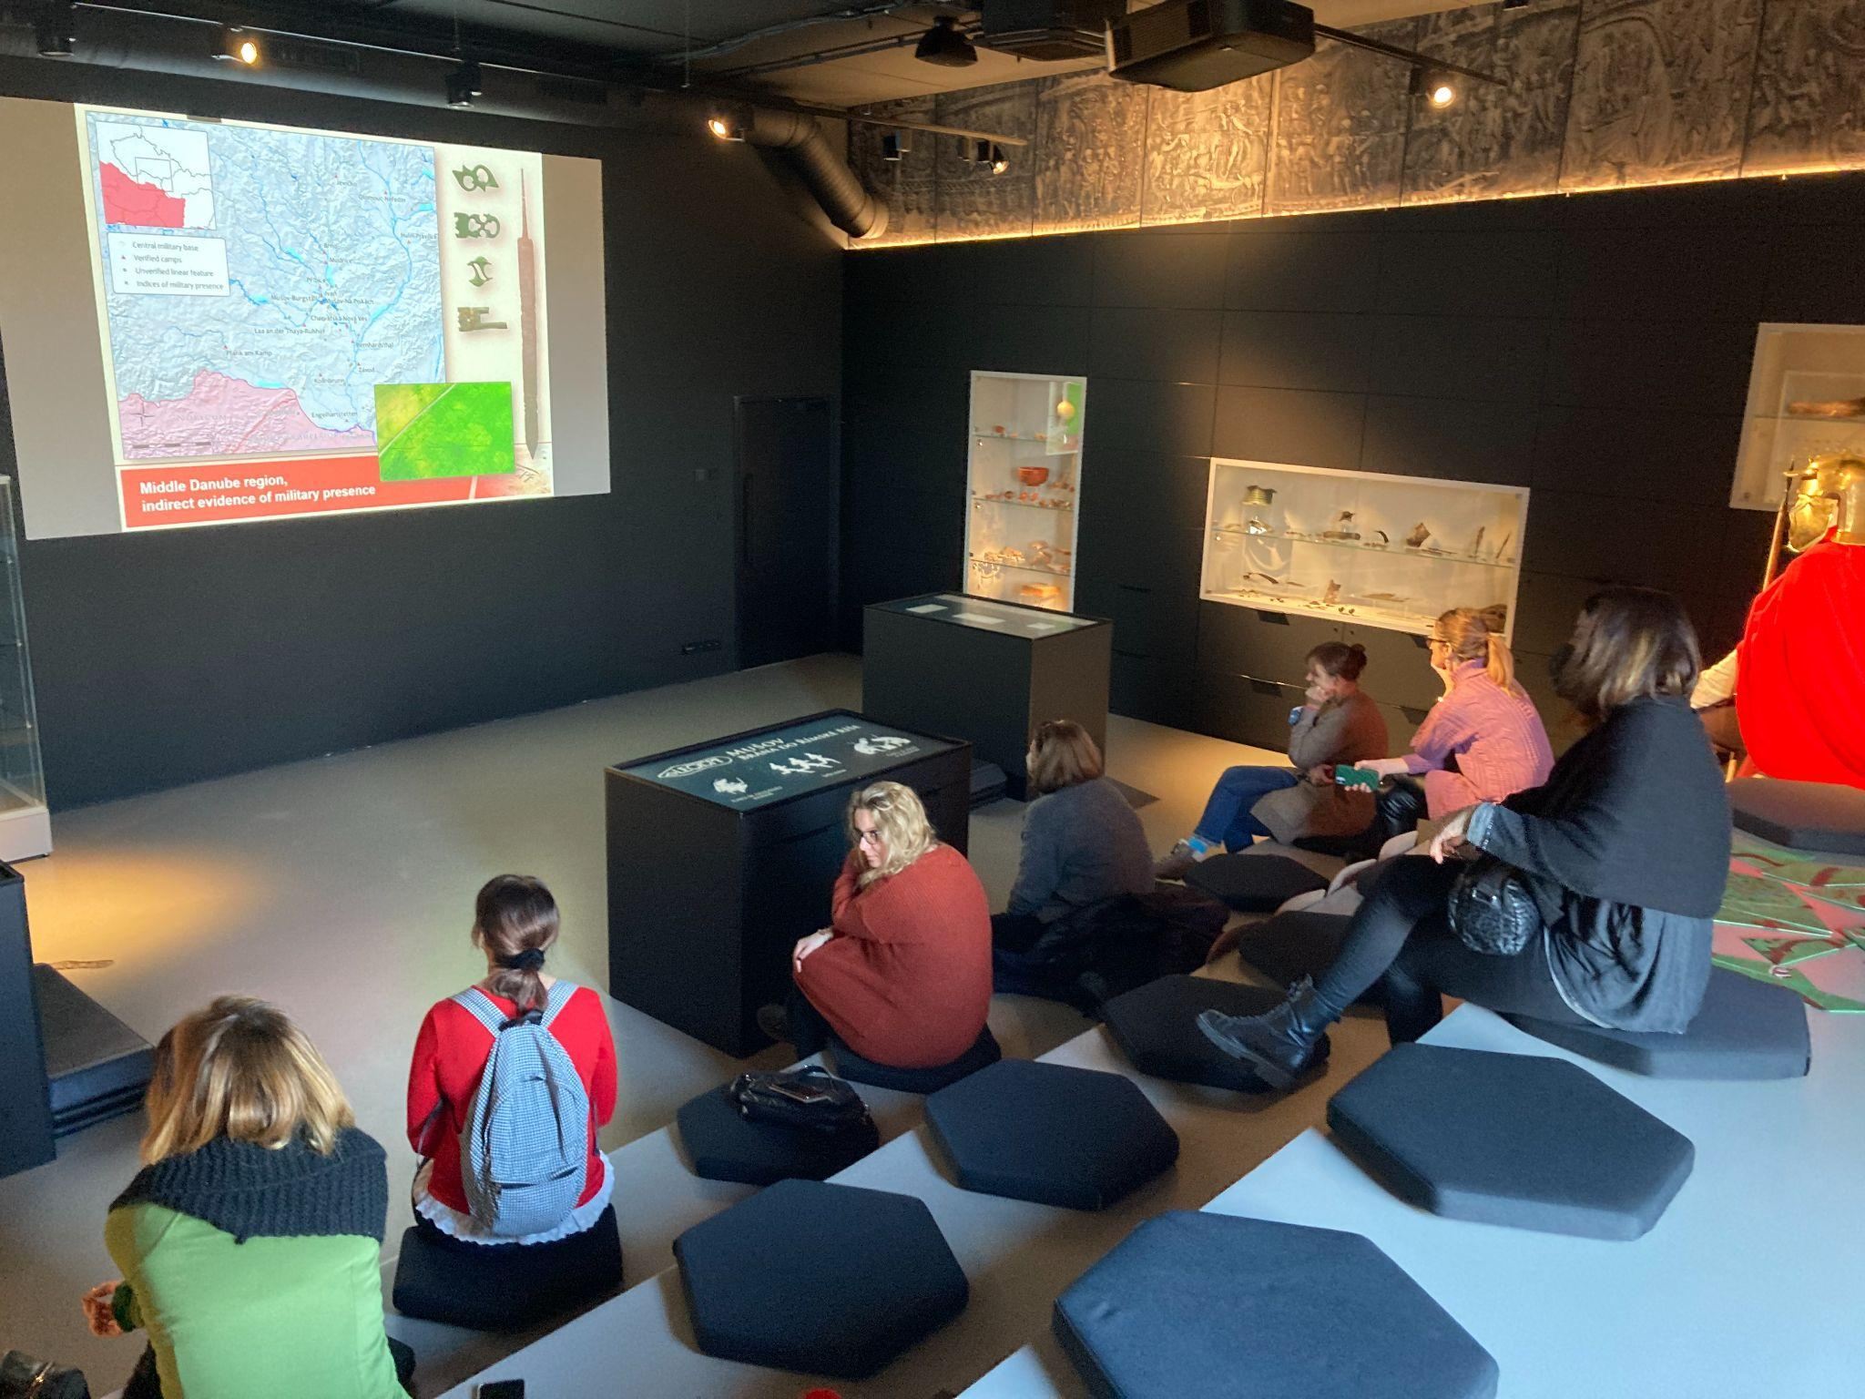
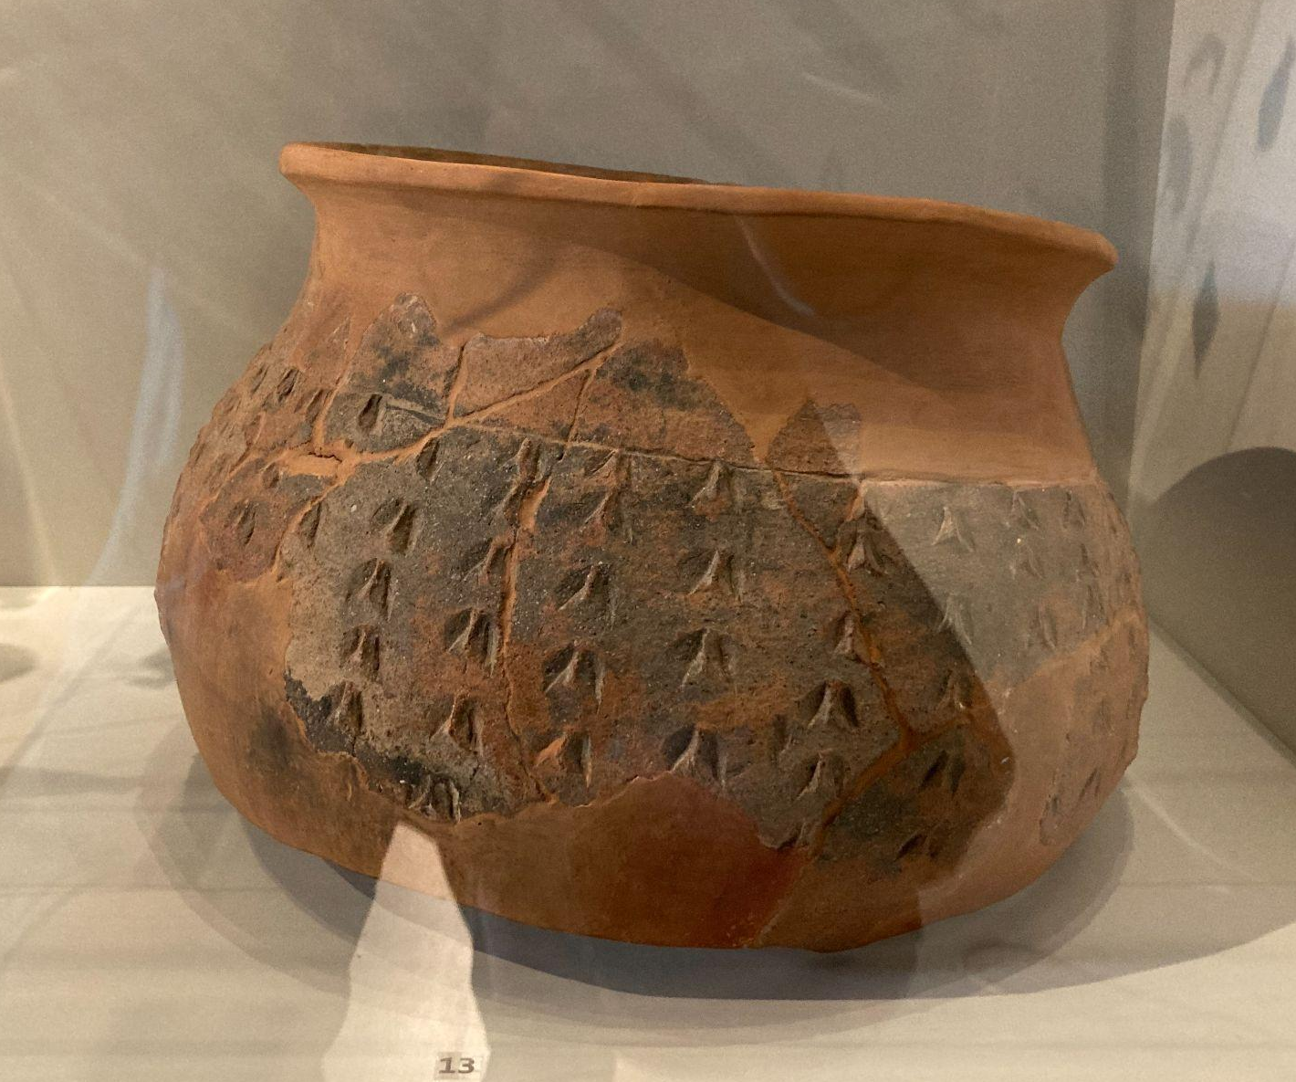
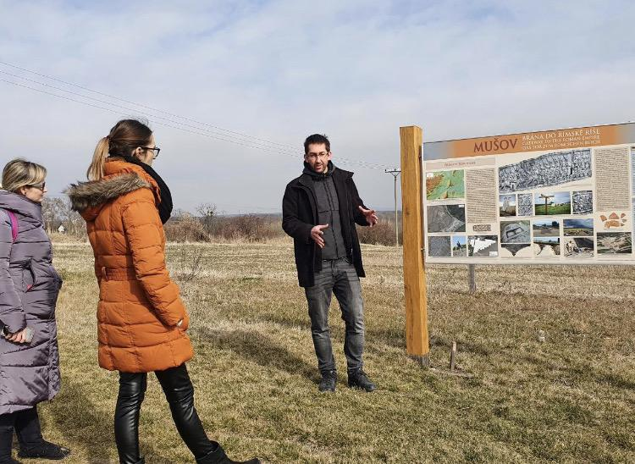
Mgr. Marek Vlach, Ph.D.: Gateway to the Roman Empire
Institute of Archeology Brno

Slide 15
Gateway to the Roman Empire
During the first centuries of our era, the Roman Empire achieved its greatest territorial extent. At this time its northern boundaries reached the Danube, whereas to the south of this river was the province of Pannonia. A very interesting development, however, also took place to the north, where the Germanic tribal communities maintained distinctively diverse relations with the Romans. They included trade exchanges, political negotiations and occasionally also intense warfare. During one of them - Marcomannic wars in the years 172-180 AD - the Roman army penetrated deep into this territory and left significant traces in the archaeological record. Within the workshop, the most important archaeological manifestations of the Roman influence and the military presence will be presented to illustrate the diversity of the Roman-Germanic interactions and also to reflect the ways of the Roman military operations on enemy territory.
Mgr. Marek Vlach, Ph.D.

Slide 16
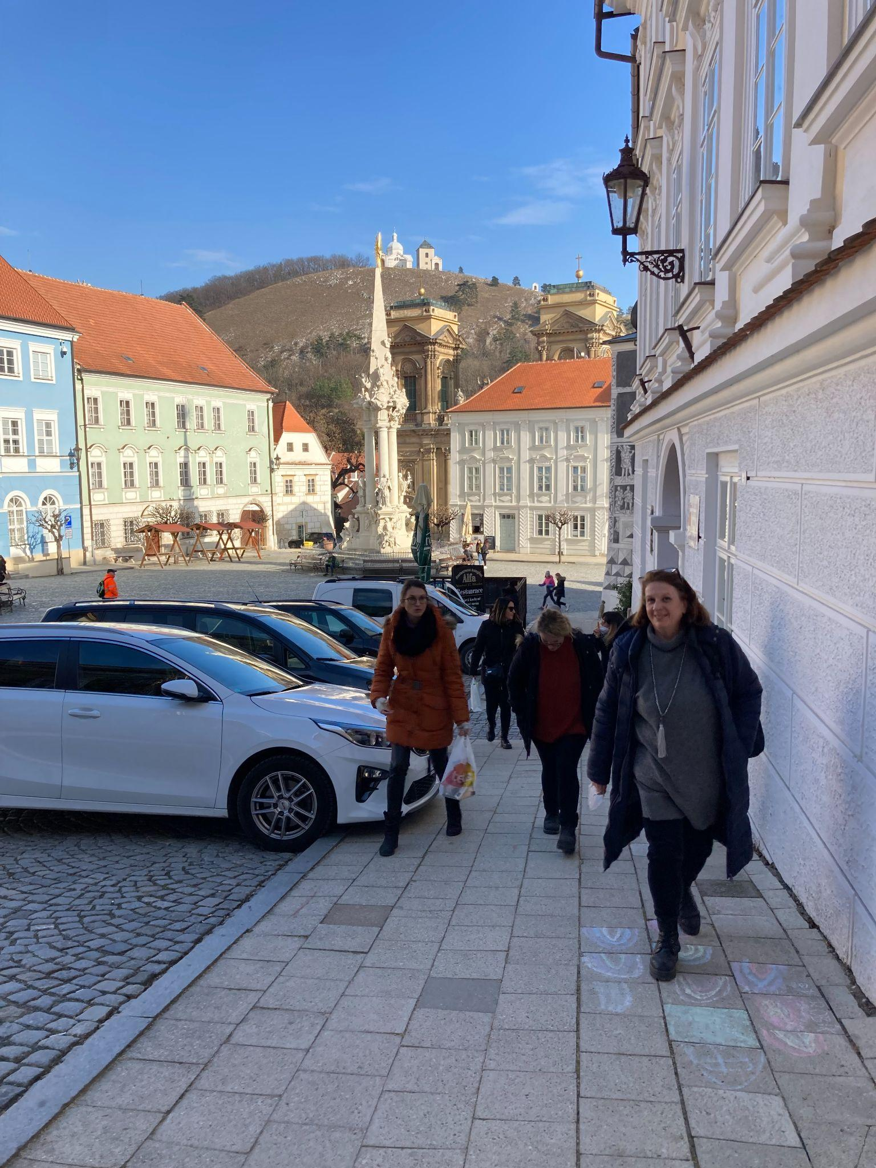
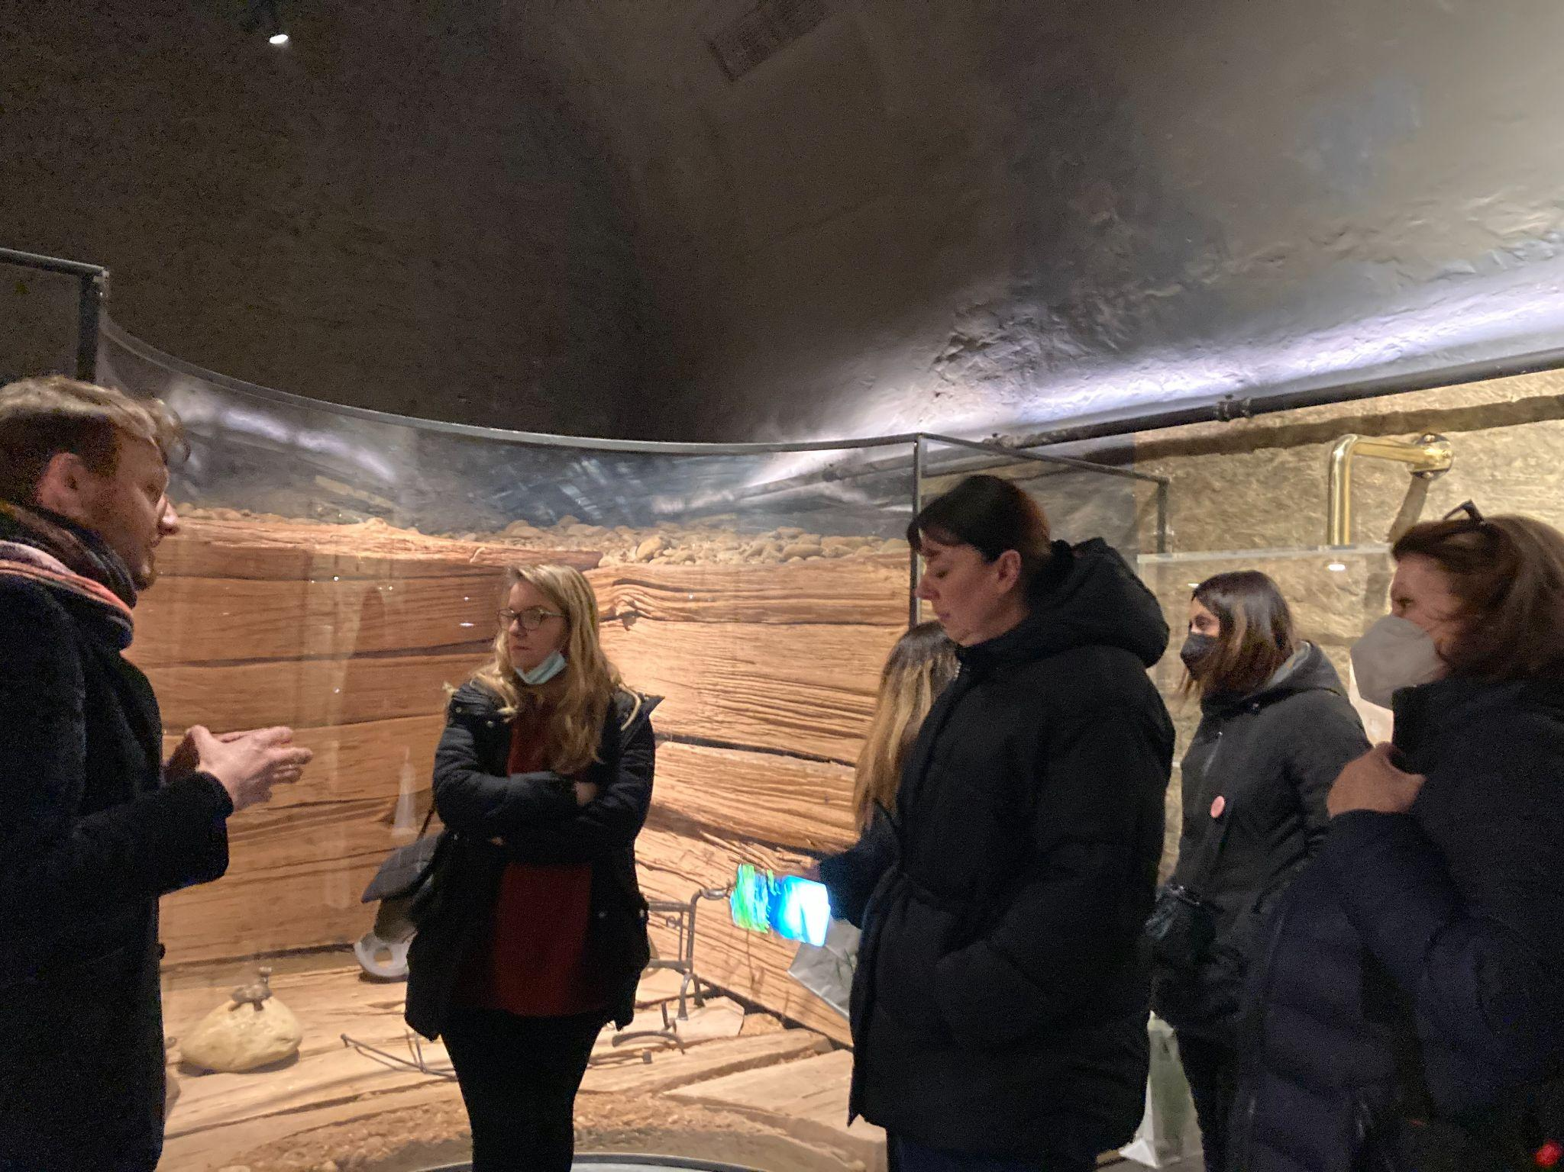
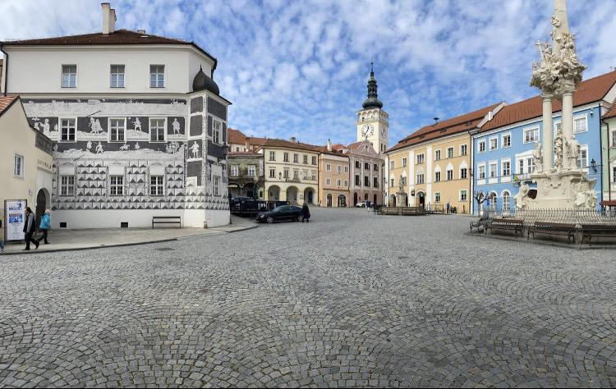
Mgr. Petr Kubín
The Romans and the Germans in the Region Under Palava
Regional Museum in Mikulov

Slide 17
The Romans and the Germans in the Region Under Palava
The exhibition "The Romans and Germans in the Region Under Pálava" is located in the cellars of the chateau, that were previously not accessible to the public, and shows the life in Moravia in the first centuries after Christ, based on archaeological findings.
Its first part shows various products of Roman workshops, that illustrate the Roman culture. Various items found in former Roman military camps in this area, are presented, too. This part of the exhibition also shows a reconstructed underfloor heating - the so called "hypocaust".
The second part presents findings that document the culture of the local population, the Germanic tribe Suebis, who lived on this territory during times of the Roman occupation. Various objects of everyday needs, such as ceramic vessels, bone combs, needles, buckles, and more are shown as a part of an idealized reconstruction of a Suebi cottage, or in the numerous showcases. Two reconstructed graves with burial artefacts found in Mikulov burial grounds show how the Germans buried their dead. The showcases hold typical items that were usually placed into urn graves, such as pottery, weapons, knives, buckles, glass beads, and others.
The highlight of the whole exhibition is a display of a unique set of findings from the tomb of the German Prince, who probably lived in the 2nd century after Christ. The tomb was discovered near the Mušov village in the 1980s. The grave is one of the richest grave findings in our country. It contained a variety of gilded belt fittings, weapons, and Roman vessels made of bronze, glass and ceramics. It is exceptional not just for the quantity of Roman objects found inside, but also for the high quality of the German items which prove the high level of the German craftsmen.
Mgr. Petr Kubín

Slide 18
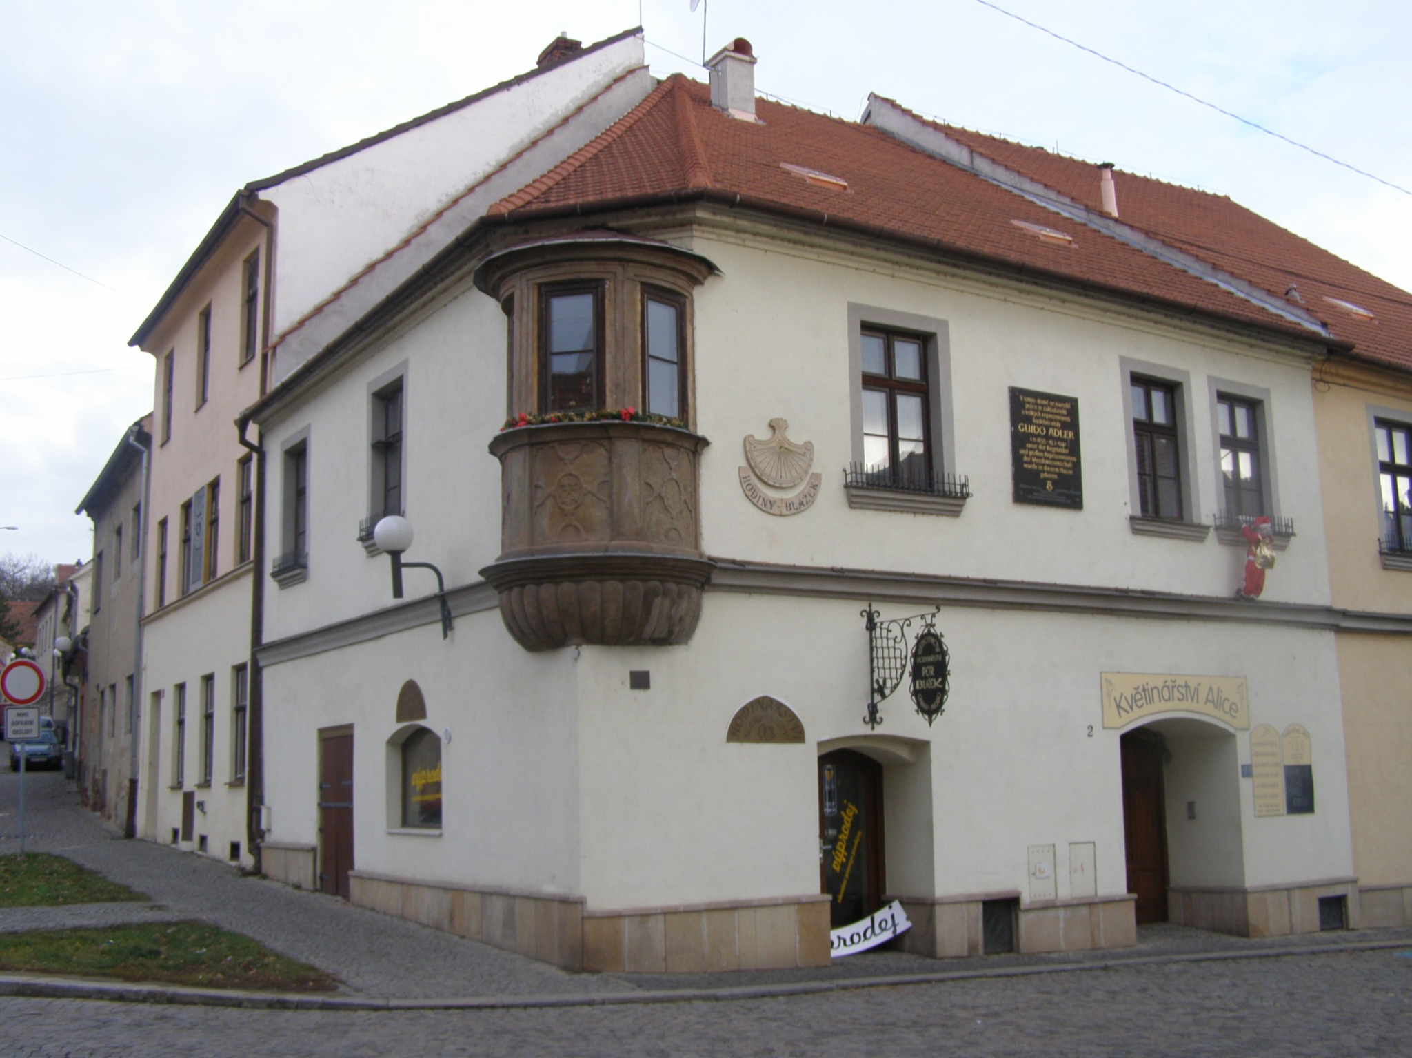
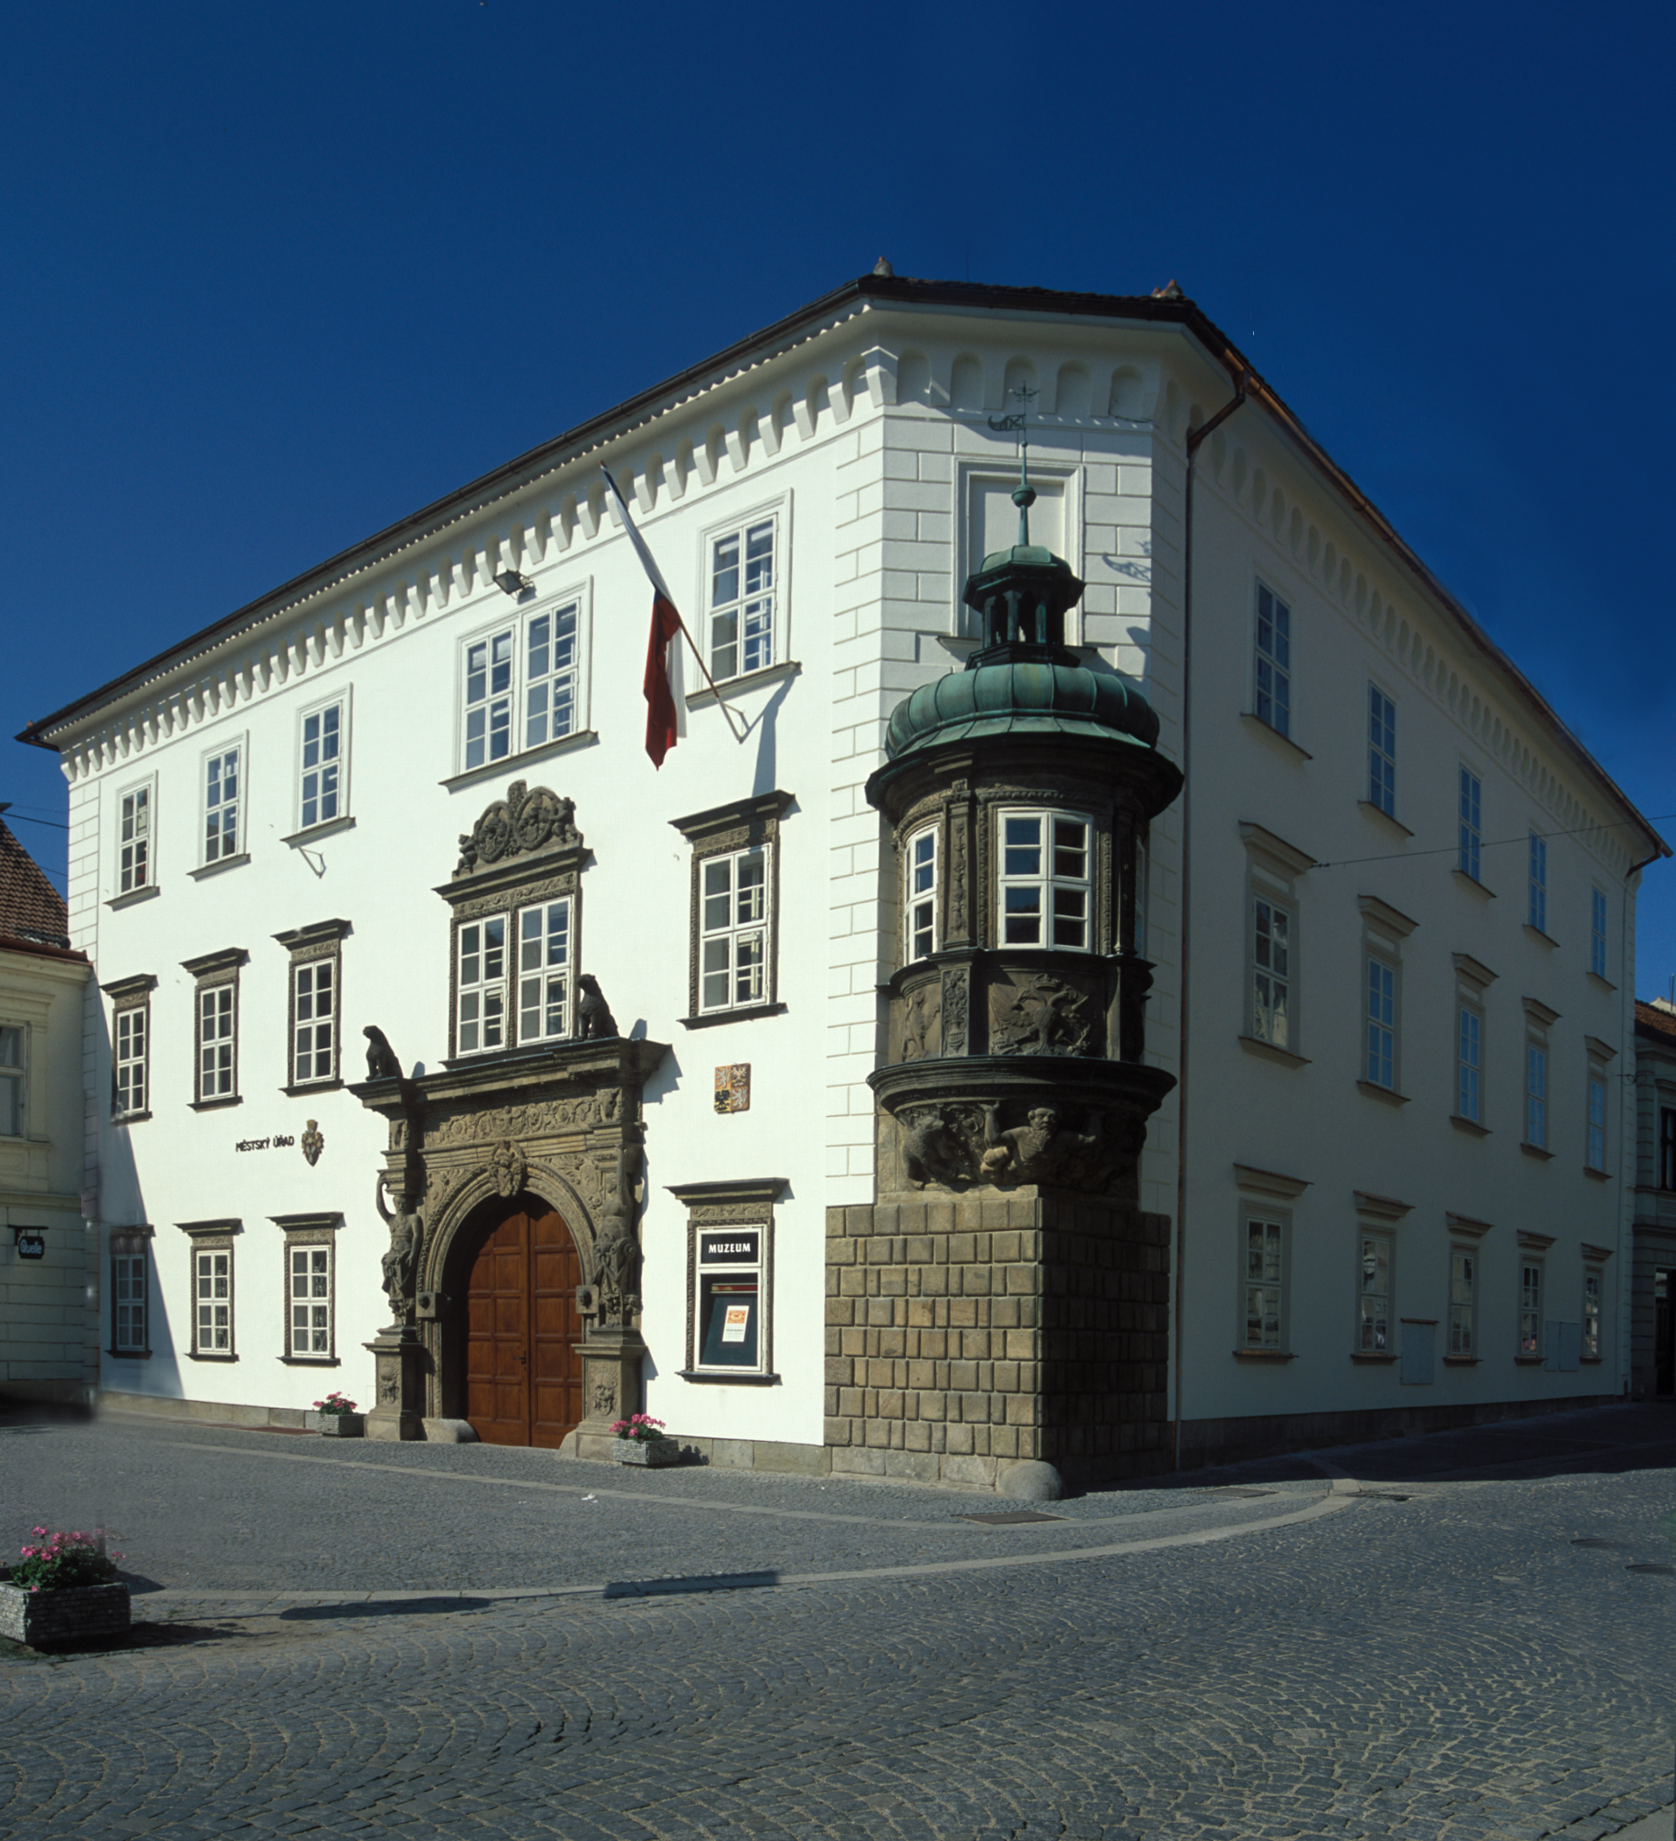
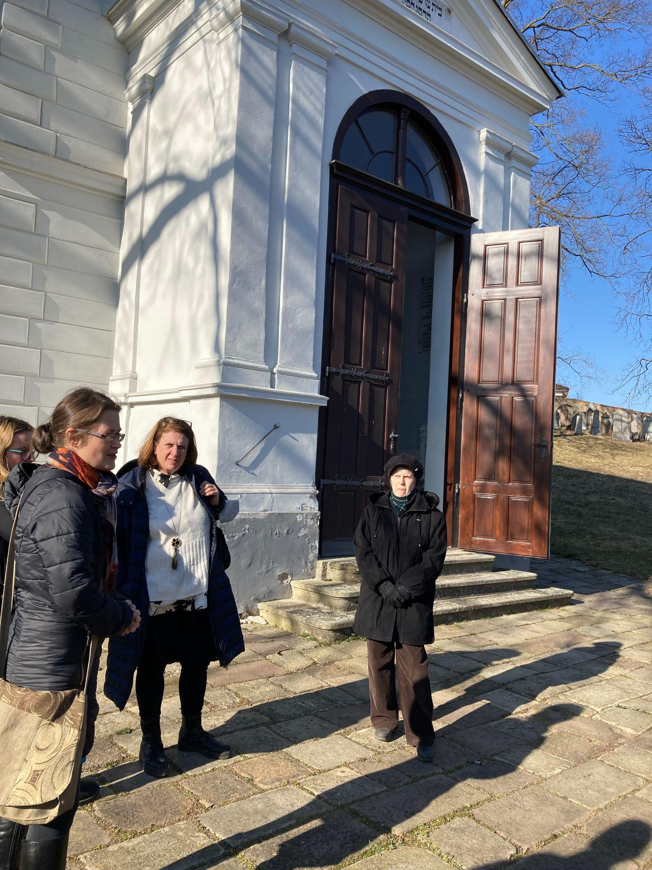
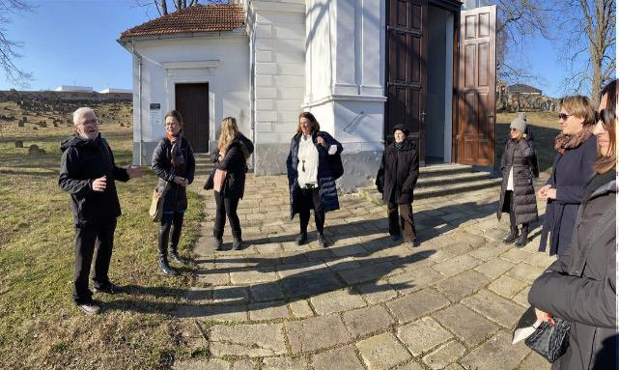
Ing. Antonín Moravec: Local history tour

Slide 19
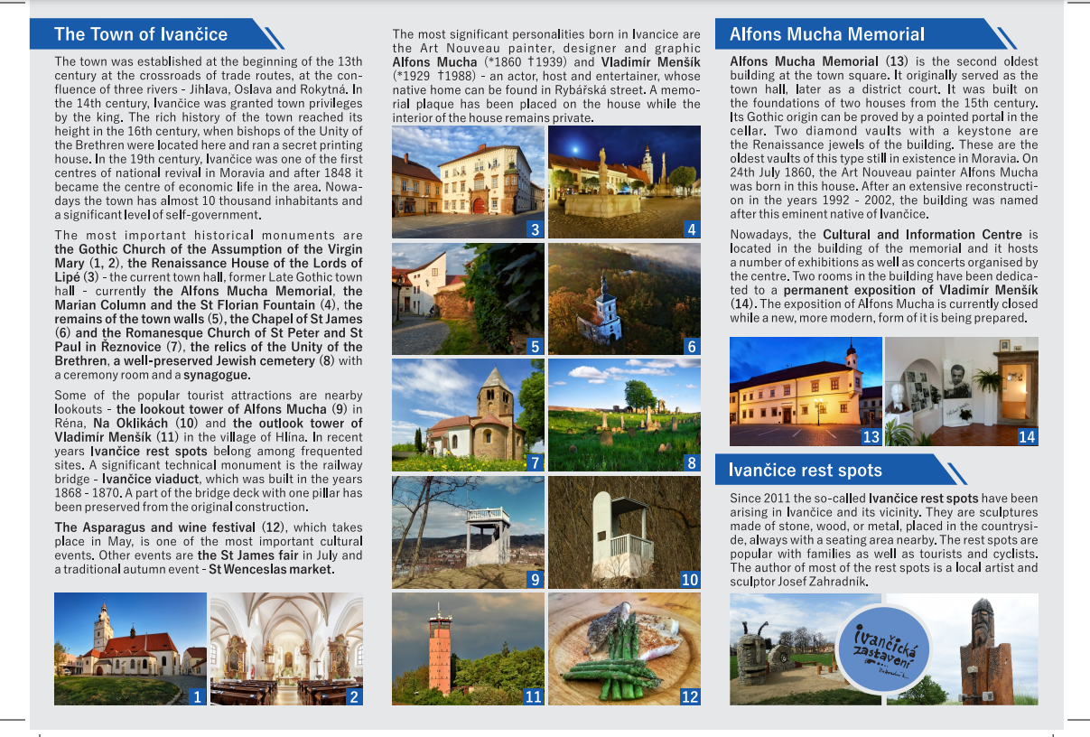

Slide 20
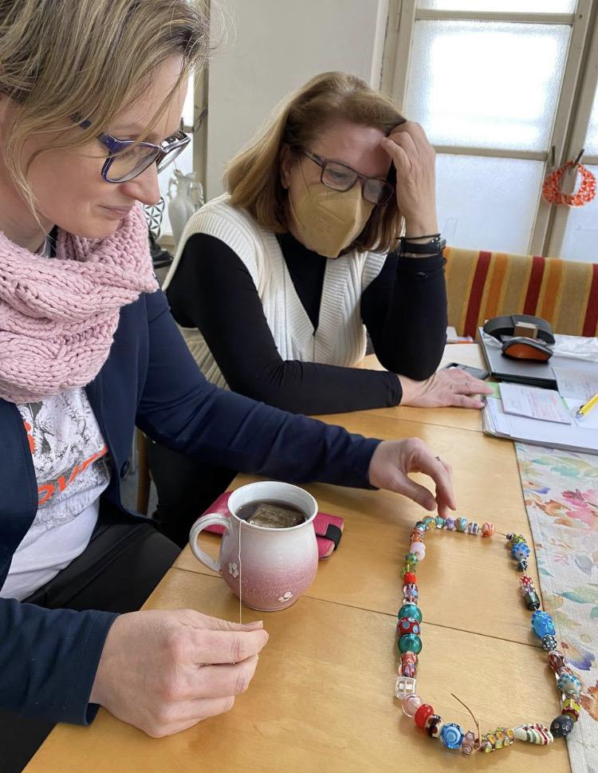
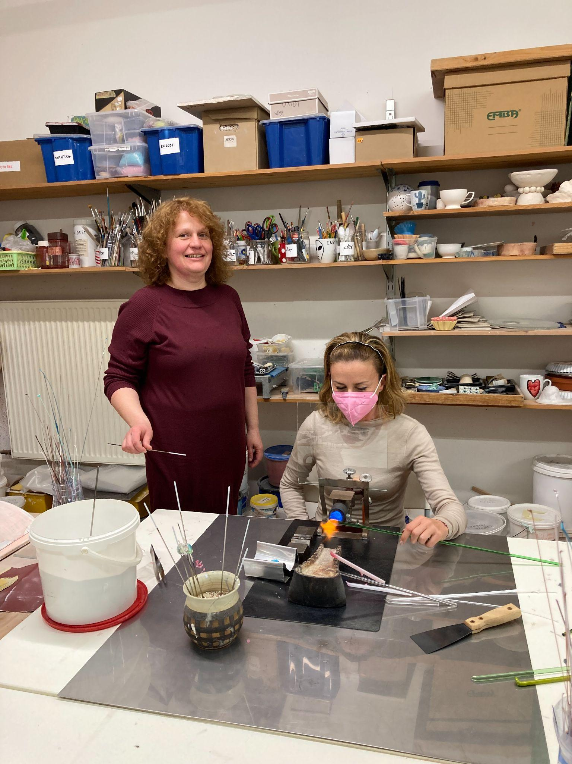
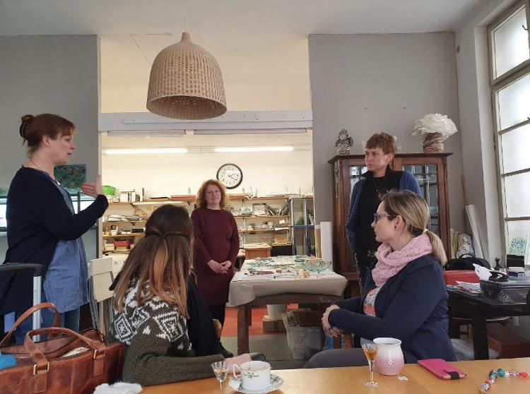
Mrs. Miroslava Svehlova: Glass Beads
Artissimo ateliér Brno

Slide 21
Glass Beads
Beads are one of the earliest forms of decoration known to man and the history of beads goes back at least 100,000 years. The earliest known examples of handmade beads were created in
Glass beads were first created about 3,500 years ago in Egypt and Mesopotamia.
During the 1st century BC, when Roman Empire conquered Egypt, Roman masters learned the glass-making craft. They introduced hotter and larger ovens enabling the production of more fluid glass mixture. Then Romans started using glass blowing pipes, which revolutionized the glass-making process and made it possible to produce large quantities of glass articles relatively cheaply. This combined with multitude of Rome's trade routes used at the time made glass pieces very popular and accessible to much wider audience than before. In this period Romans used sophisticated glassmaking techniques, including Millefiori, to create not only beads and tableware pieces, but also glass windows and mosaic tiles for their baths, floors, fountains, and walls.
As Christianity took hold in Europe, with its emphasis on austerity and disapproval of vanity, European culture and traditions started to change. However, these beads were relatively simple as many of the Roman glass-making techniques and methods were gradually lost.
The decline of the glass bead-making in Europe continued until the 12th century when the growing power of the Venetian Republic and its commercial success gave rise to the revival of various forms of arts and crafts in Venice.
Later in 1470 Venetian artisans (who were by then moved onto Murano Island) started to create hollow cylindrical glass canes which were cut and refined by grinding or heating, re-discovery of many Roman techniques, including Sommerso, gold and silver leaf, and copper-infused avventurina.
In the 15th century Venetian glass masters re-discovered Millefiori technique. The most famous of Venetian Millefiori beads is Rosetta bead (aka Chevron bead).
After Napoleon's defeat of Venice in 1797 Venetian glass-making industry greatly suffered and declined. Supported by the Austrians, other glass-making centers quickly developed using Venetian knowledge and experience, most notably in Bohemia. By the end of the nineteenth century Bohemia became a well-established center for glass bead production. Production of high-quality crystal also flourished in and around Bohemia and multiple crystal bead making firms were established in the region, including world-famous Swarovski.
For more info see: https://www.glassofvenice.com/venetian_beads_history.php

Slide 22
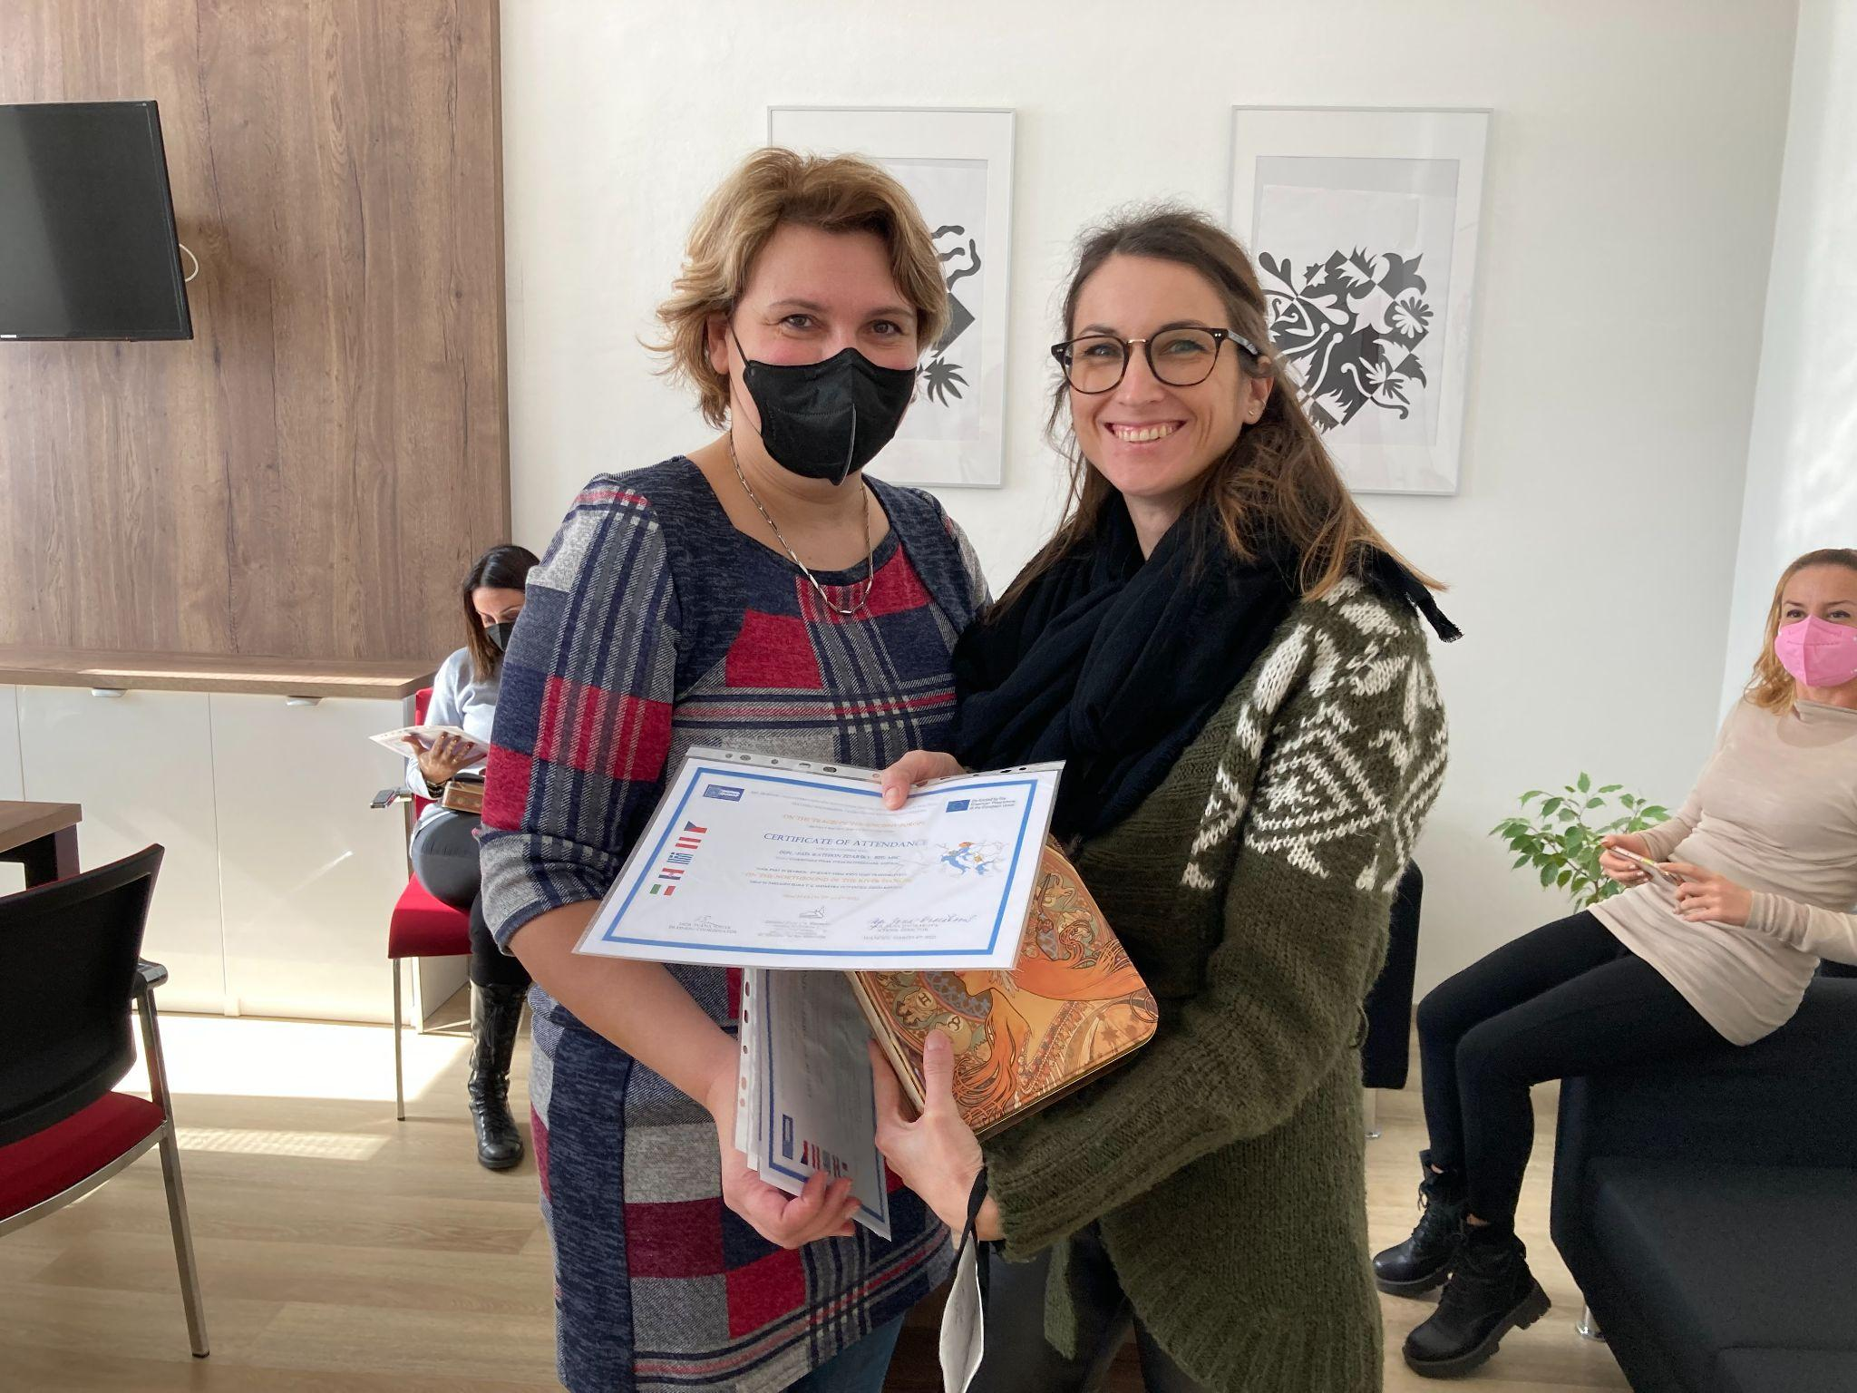
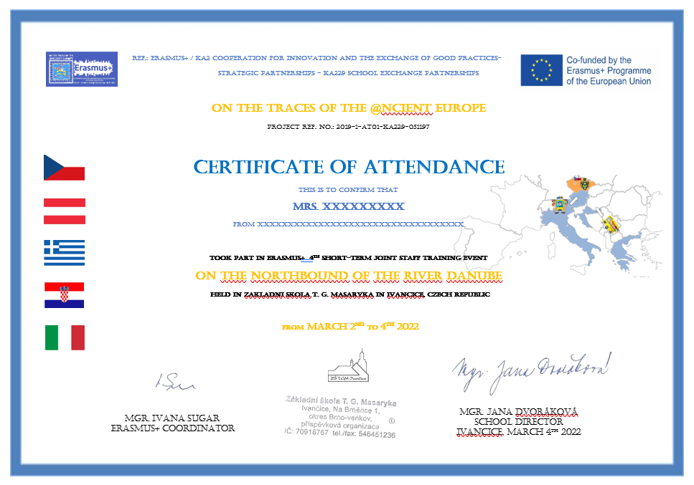
Certificates

Slide 23
Information about next
Stuff Joint Meeting in Croatia and Italy
Mobility C2: Croatia 2nd - 4th May 2022
Mobility C5: Croatia 2nd - 4th May 2022
Mobility C7: Italy 30th May - 2nd June 2022

Slide 24
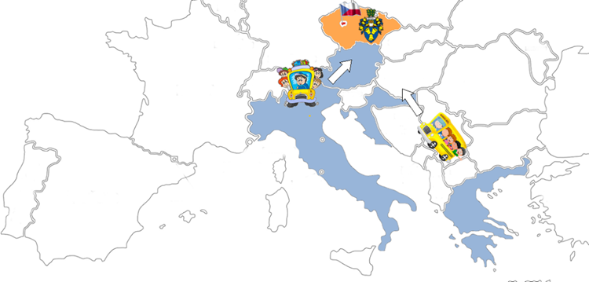
See you later, Erasmus+ friends!

